Slide 1

RED HAT 3Scale
_{API Management Workshop}
March, 2021
Tommer Amber, Senior Cloud Security Consultant
Red Hat Professional Services, Israel

Slide 2
Agenda
APIs - Background & Types of Web APIs
API Management Lifecycle
3Scale - Overview
Day Two Deployment Options
API Security
Automation
Notes:
APIs are the language of digital business. It’s tough to find a company or organization these days that is not exposing APIs to users, customers, clients, and partners as part of their digital transformation. Examples of capabilities required for traditional API programs include:
Scale to large numbers of APIs and request volume
End-to-end security with TLS
Flexible deployment and traffic routing features to support A/B, Blue/Green, Canary deployments
Developer portal to engage and onboard API clients
Client authentication and authorization
Application-level policy control
Analytics
API management is typically used in “north south” architectures where API clients live beyond trust and/or organizational boundaries.
When adopting a next gen application platform for your enterprise, consider what support the platform has for these ‘table stakes’ requirements for an API program.

Slide 3
BACKGROUND

Slide 4
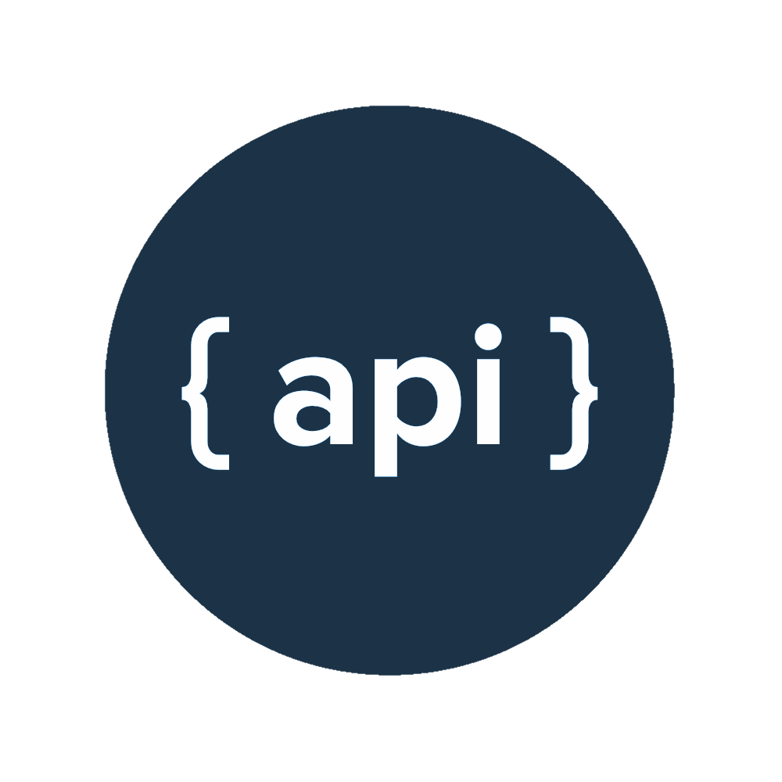
WHAT IS AN API?
Application
Programming
Interface
Notes:
APIs are the language of digital business. It’s tough to find a company or organization these days that is not exposing APIs to users, customers, clients, and partners as part of their digital transformation. Examples of capabilities required for traditional API programs include:
Scale to large numbers of APIs and request volume
End-to-end security with TLS
Flexible deployment and traffic routing features to support A/B, Blue/Green, Canary deployments
Developer portal to engage and onboard API clients
Client authentication and authorization
Application-level policy control
Analytics
API management is typically used in “north south” architectures where API clients live beyond trust and/or organizational boundaries.
When adopting a next gen application platform for your enterprise, consider what support the platform has for these ‘table stakes’ requirements for an API program.

Slide 5
WHAT IS AN API?
“Software component or a system, externally exposed, that defines how other components or systems can use it”
It defines the kinds of calls or requests that can be made, how to make them, the data formats that should be used etc.
Notes:
APIs are the language of digital business. It’s tough to find a company or organization these days that is not exposing APIs to users, customers, clients, and partners as part of their digital transformation. Examples of capabilities required for traditional API programs include:
Scale to large numbers of APIs and request volume
End-to-end security with TLS
Flexible deployment and traffic routing features to support A/B, Blue/Green, Canary deployments
Developer portal to engage and onboard API clients
Client authentication and authorization
Application-level policy control
Analytics
API management is typically used in “north south” architectures where API clients live beyond trust and/or organizational boundaries.
When adopting a next gen application platform for your enterprise, consider what support the platform has for these ‘table stakes’ requirements for an API program.

Slide 6

WHAT IS AN API?
Machine’s API == “I understand requests in the following formats only”
Notes:
APIs are the language of digital business. It’s tough to find a company or organization these days that is not exposing APIs to users, customers, clients, and partners as part of their digital transformation. Examples of capabilities required for traditional API programs include:
Scale to large numbers of APIs and request volume
End-to-end security with TLS
Flexible deployment and traffic routing features to support A/B, Blue/Green, Canary deployments
Developer portal to engage and onboard API clients
Client authentication and authorization
Application-level policy control
Analytics
API management is typically used in “north south” architectures where API clients live beyond trust and/or organizational boundaries.
When adopting a next gen application platform for your enterprise, consider what support the platform has for these ‘table stakes’ requirements for an API program.

Slide 7
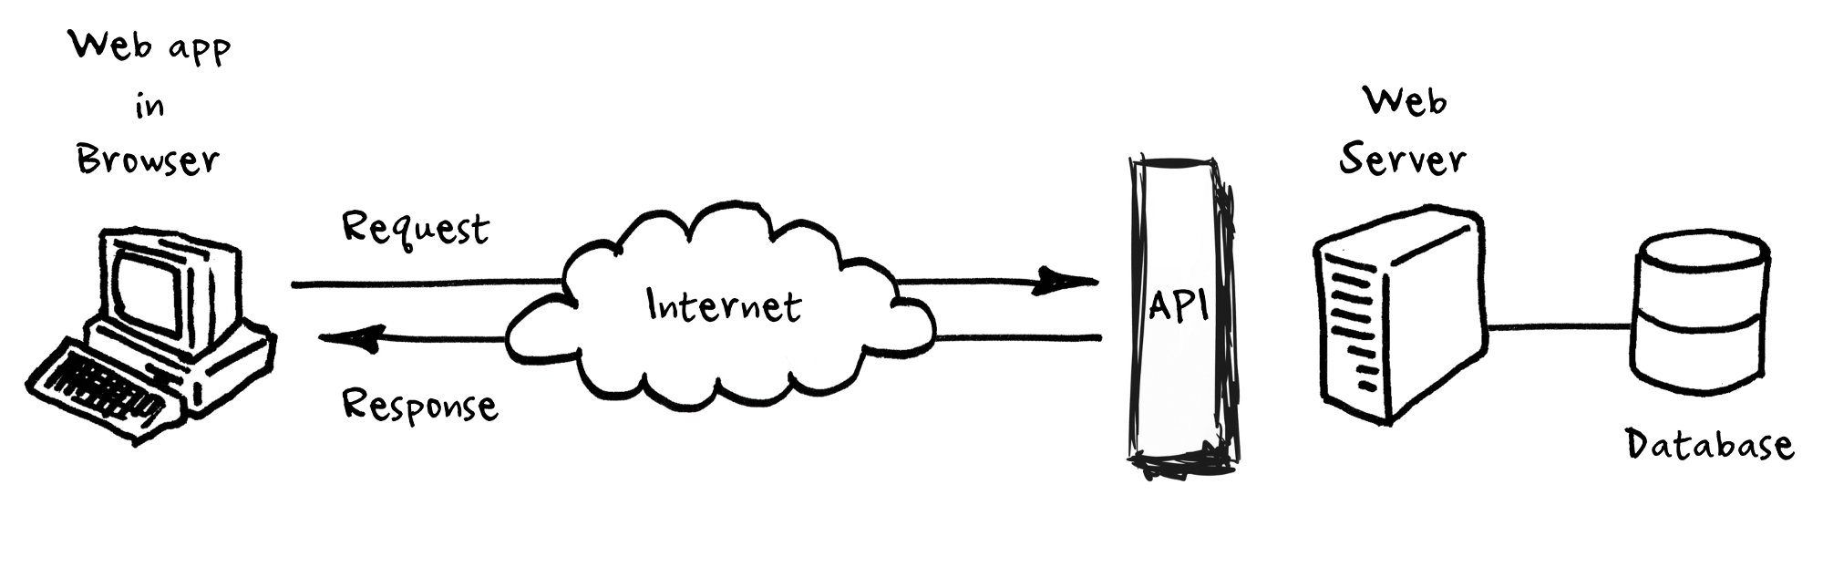

API-exposure architecture - Simplified
The most famous example of them all
Notes:
APIs are the language of digital business. It’s tough to find a company or organization these days that is not exposing APIs to users, customers, clients, and partners as part of their digital transformation. Examples of capabilities required for traditional API programs include:
Scale to large numbers of APIs and request volume
End-to-end security with TLS
Flexible deployment and traffic routing features to support A/B, Blue/Green, Canary deployments
Developer portal to engage and onboard API clients
Client authentication and authorization
Application-level policy control
Analytics
API management is typically used in “north south” architectures where API clients live beyond trust and/or organizational boundaries.
When adopting a next gen application platform for your enterprise, consider what support the platform has for these ‘table stakes’ requirements for an API program.

Slide 8








APIs Are Everywhere!
Mission critical to every business (or soon every business)
Customers and partners depend on it
Fundamental to company agility and competitiveness
(It is basically a standard nowadays)
Web and mobile depend on APIs
And not only them
{ API }
Notes:
APIs are the language of digital business. It’s tough to find a company or organization these days that is not exposing APIs to users, customers, clients, and partners as part of their digital transformation. Examples of capabilities required for traditional API programs include:
Scale to large numbers of APIs and request volume
End-to-end security with TLS
Flexible deployment and traffic routing features to support A/B, Blue/Green, Canary deployments
Developer portal to engage and onboard API clients
Client authentication and authorization
Application-level policy control
Analytics
API management is typically used in “north south” architectures where API clients live beyond trust and/or organizational boundaries.
When adopting a next gen application platform for your enterprise, consider what support the platform has for these ‘table stakes’ requirements for an API program.

Slide 9

API Economy
API As A Service
Supplier & Consumer
Customers (Apps functionality)
Partners (Develop new products)
Bridge between IT vs. Business
Forms of consumption
C2B - Customer-to-Business (Web, Mobile, Apps)
B2B - Business-to-Business (Internally & Externally)
API Access Monetization Question - How?
Notes:
APIs are the language of digital business. It’s tough to find a company or organization these days that is not exposing APIs to users, customers, clients, and partners as part of their digital transformation. Examples of capabilities required for traditional API programs include:
Scale to large numbers of APIs and request volume
End-to-end security with TLS
Flexible deployment and traffic routing features to support A/B, Blue/Green, Canary deployments
Developer portal to engage and onboard API clients
Client authentication and authorization
Application-level policy control
Analytics
API management is typically used in “north south” architectures where API clients live beyond trust and/or organizational boundaries.
When adopting a next gen application platform for your enterprise, consider what support the platform has for these ‘table stakes’ requirements for an API program.

Slide 10
APIs - in depth
https://rapidapi.com/blog/types-of-apis/

Slide 11
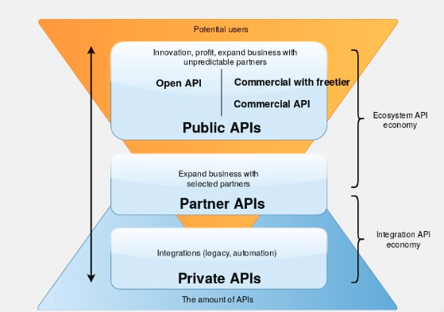
API Categories
Open APIs
I.e. GoogleMaps
Private APIs
Intermediate consumption only
Internal DB / Organizational Shared Resource
Partner APIs
Github
Cross organizational products’ development (e.g. SaaS)
Notes:
APIs are the language of digital business. It’s tough to find a company or organization these days that is not exposing APIs to users, customers, clients, and partners as part of their digital transformation. Examples of capabilities required for traditional API programs include:
Scale to large numbers of APIs and request volume
End-to-end security with TLS
Flexible deployment and traffic routing features to support A/B, Blue/Green, Canary deployments
Developer portal to engage and onboard API clients
Client authentication and authorization
Application-level policy control
Analytics
API management is typically used in “north south” architectures where API clients live beyond trust and/or organizational boundaries.
When adopting a next gen application platform for your enterprise, consider what support the platform has for these ‘table stakes’ requirements for an API program.

Slide 12
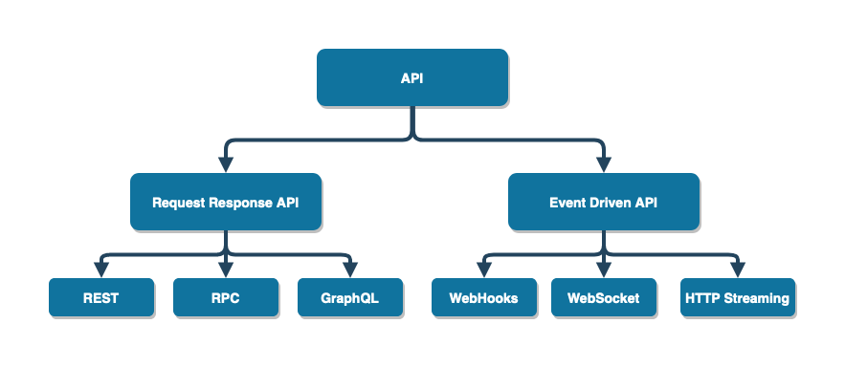
https://laptrinhx.com/comparing-api-architectural-styles-soap-vs-rest-vs-graphql-vs-rpc-1726803065/
Notes:
APIs are the language of digital business. It’s tough to find a company or organization these days that is not exposing APIs to users, customers, clients, and partners as part of their digital transformation. Examples of capabilities required for traditional API programs include:
Scale to large numbers of APIs and request volume
End-to-end security with TLS
Flexible deployment and traffic routing features to support A/B, Blue/Green, Canary deployments
Developer portal to engage and onboard API clients
Client authentication and authorization
Application-level policy control
Analytics
API management is typically used in “north south” architectures where API clients live beyond trust and/or organizational boundaries.
When adopting a next gen application platform for your enterprise, consider what support the platform has for these ‘table stakes’ requirements for an API program.

Slide 13
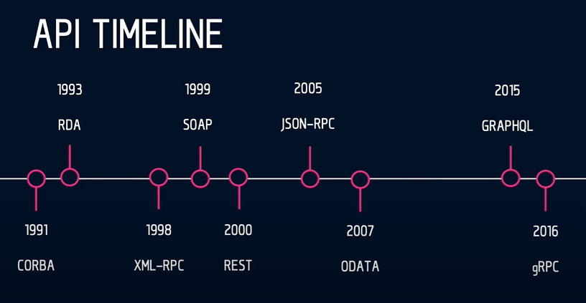
Notes:
APIs are the language of digital business. It’s tough to find a company or organization these days that is not exposing APIs to users, customers, clients, and partners as part of their digital transformation. Examples of capabilities required for traditional API programs include:
Scale to large numbers of APIs and request volume
End-to-end security with TLS
Flexible deployment and traffic routing features to support A/B, Blue/Green, Canary deployments
Developer portal to engage and onboard API clients
Client authentication and authorization
Application-level policy control
Analytics
API management is typically used in “north south” architectures where API clients live beyond trust and/or organizational boundaries.
When adopting a next gen application platform for your enterprise, consider what support the platform has for these ‘table stakes’ requirements for an API program.

Slide 14
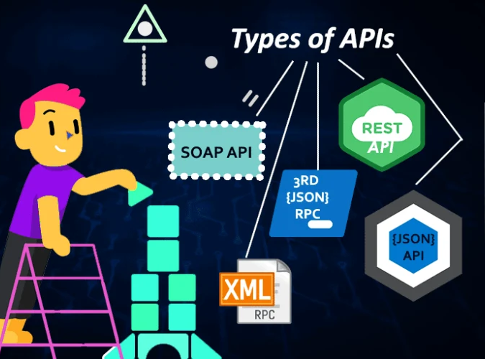
Web (HTTP/S) API Types
(Most Popular)
RESTful API
CURD oriented
E.g. Webhook
SOAP
XML based
RPC
Application Specific
XML vs. JSON
gRPC
Declarative Docs
GraphQL
Robust use cases
one to many query association
Notes:
APIs are the language of digital business. It’s tough to find a company or organization these days that is not exposing APIs to users, customers, clients, and partners as part of their digital transformation. Examples of capabilities required for traditional API programs include:
Scale to large numbers of APIs and request volume
End-to-end security with TLS
Flexible deployment and traffic routing features to support A/B, Blue/Green, Canary deployments
Developer portal to engage and onboard API clients
Client authentication and authorization
Application-level policy control
Analytics
API management is typically used in “north south” architectures where API clients live beyond trust and/or organizational boundaries.
When adopting a next gen application platform for your enterprise, consider what support the platform has for these ‘table stakes’ requirements for an API program.

Slide 15
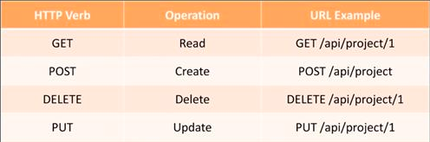
RESTful API
Notes:
APIs are the language of digital business. It’s tough to find a company or organization these days that is not exposing APIs to users, customers, clients, and partners as part of their digital transformation. Examples of capabilities required for traditional API programs include:
Scale to large numbers of APIs and request volume
End-to-end security with TLS
Flexible deployment and traffic routing features to support A/B, Blue/Green, Canary deployments
Developer portal to engage and onboard API clients
Client authentication and authorization
Application-level policy control
Analytics
API management is typically used in “north south” architectures where API clients live beyond trust and/or organizational boundaries.
When adopting a next gen application platform for your enterprise, consider what support the platform has for these ‘table stakes’ requirements for an API program.

Slide 16
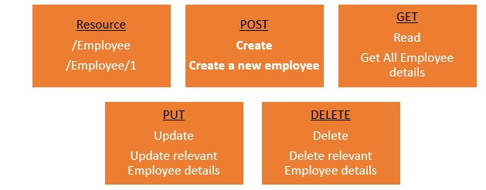
Small Example
Notes:
APIs are the language of digital business. It’s tough to find a company or organization these days that is not exposing APIs to users, customers, clients, and partners as part of their digital transformation. Examples of capabilities required for traditional API programs include:
Scale to large numbers of APIs and request volume
End-to-end security with TLS
Flexible deployment and traffic routing features to support A/B, Blue/Green, Canary deployments
Developer portal to engage and onboard API clients
Client authentication and authorization
Application-level policy control
Analytics
API management is typically used in “north south” architectures where API clients live beyond trust and/or organizational boundaries.
When adopting a next gen application platform for your enterprise, consider what support the platform has for these ‘table stakes’ requirements for an API program.

Slide 17
RESTful API
REST = Representational State Transfer
Interactive applications that use Web services
OR
Non-Interactive automation mechanisms
PreDetermined calls (GET, POST, UPDATE, DELETE)
payloads lighter
REST APIs uses different data formats
plain text (raw) , HTML, XML, and JSON sending payload
Stateless
Notes:
APIs are the language of digital business. It’s tough to find a company or organization these days that is not exposing APIs to users, customers, clients, and partners as part of their digital transformation. Examples of capabilities required for traditional API programs include:
Scale to large numbers of APIs and request volume
End-to-end security with TLS
Flexible deployment and traffic routing features to support A/B, Blue/Green, Canary deployments
Developer portal to engage and onboard API clients
Client authentication and authorization
Application-level policy control
Analytics
API management is typically used in “north south” architectures where API clients live beyond trust and/or organizational boundaries.
When adopting a next gen application platform for your enterprise, consider what support the platform has for these ‘table stakes’ requirements for an API program.

Slide 18
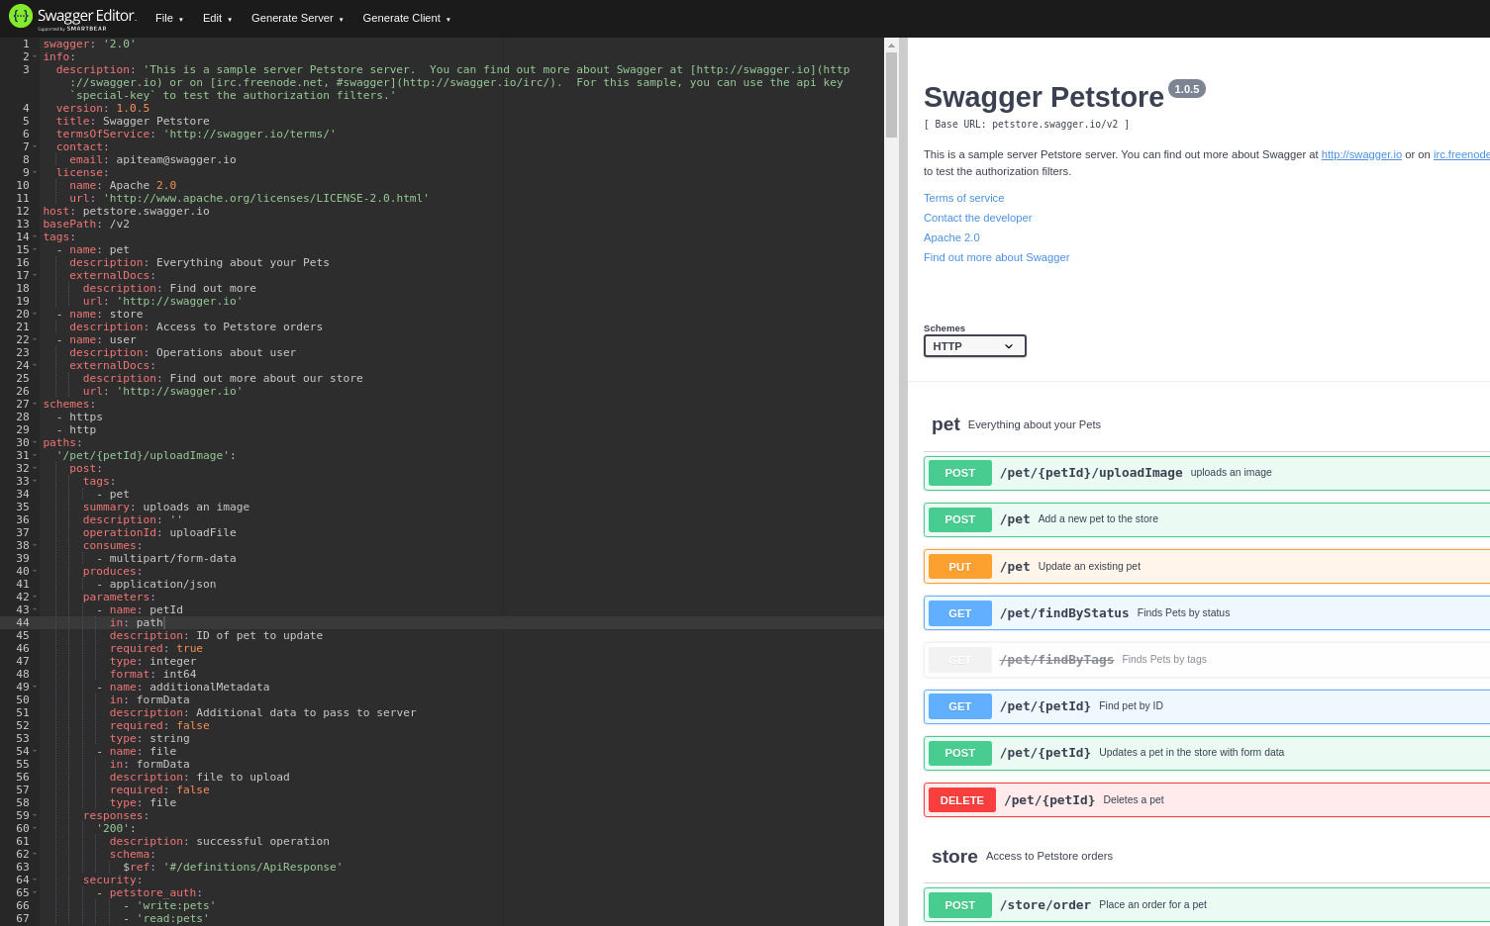
Swagger Editor
API Specification Visualization
Swagger editor
File ⇒ import url ⇒ https://petstore.swagger.io/v2/swagger.json
Notes:
APIs are the language of digital business. It’s tough to find a company or organization these days that is not exposing APIs to users, customers, clients, and partners as part of their digital transformation. Examples of capabilities required for traditional API programs include:
Scale to large numbers of APIs and request volume
End-to-end security with TLS
Flexible deployment and traffic routing features to support A/B, Blue/Green, Canary deployments
Developer portal to engage and onboard API clients
Client authentication and authorization
Application-level policy control
Analytics
API management is typically used in “north south” architectures where API clients live beyond trust and/or organizational boundaries.
When adopting a next gen application platform for your enterprise, consider what support the platform has for these ‘table stakes’ requirements for an API program.

Slide 19
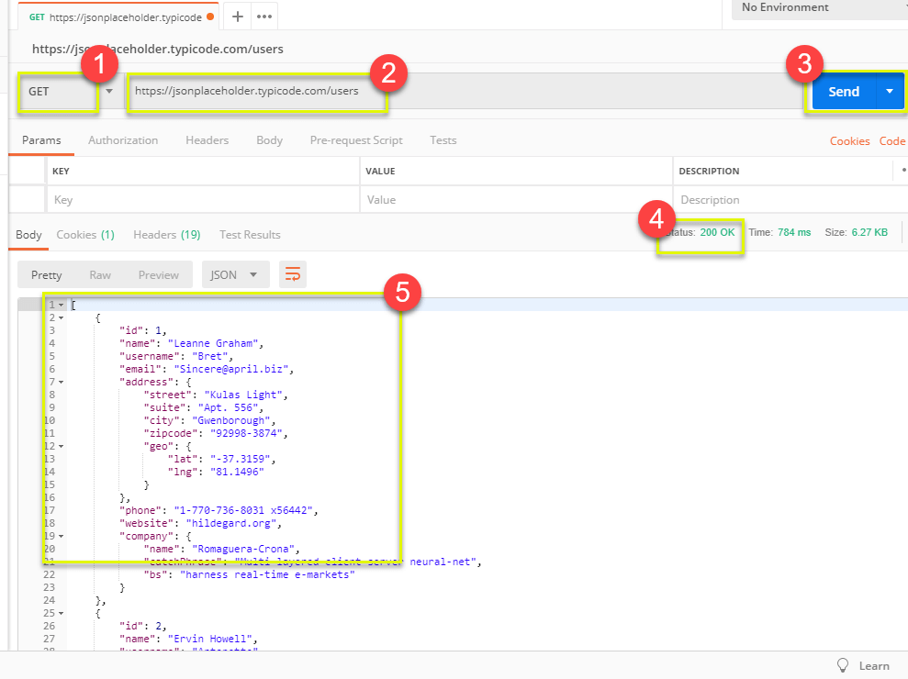
Postman
Testing Tool
https://www.postman.com/
Notes:
APIs are the language of digital business. It’s tough to find a company or organization these days that is not exposing APIs to users, customers, clients, and partners as part of their digital transformation. Examples of capabilities required for traditional API programs include:
Scale to large numbers of APIs and request volume
End-to-end security with TLS
Flexible deployment and traffic routing features to support A/B, Blue/Green, Canary deployments
Developer portal to engage and onboard API clients
Client authentication and authorization
Application-level policy control
Analytics
API management is typically used in “north south” architectures where API clients live beyond trust and/or organizational boundaries.
When adopting a next gen application platform for your enterprise, consider what support the platform has for these ‘table stakes’ requirements for an API program.

Slide 20
SOAP - Simple Object Access Protocol
An established web API protocol
Can also be implemented for TCP, SMTP etc.
(HTTP) Header, XML Body
Compatible with schema
WSDL - Web Services Definition Language
Dictionary of APIs accessible
Swagger Equivalent
Notes:
APIs are the language of digital business. It’s tough to find a company or organization these days that is not exposing APIs to users, customers, clients, and partners as part of their digital transformation. Examples of capabilities required for traditional API programs include:
Scale to large numbers of APIs and request volume
End-to-end security with TLS
Flexible deployment and traffic routing features to support A/B, Blue/Green, Canary deployments
Developer portal to engage and onboard API clients
Client authentication and authorization
Application-level policy control
Analytics
API management is typically used in “north south” architectures where API clients live beyond trust and/or organizational boundaries.
When adopting a next gen application platform for your enterprise, consider what support the platform has for these ‘table stakes’ requirements for an API program.

Slide 21
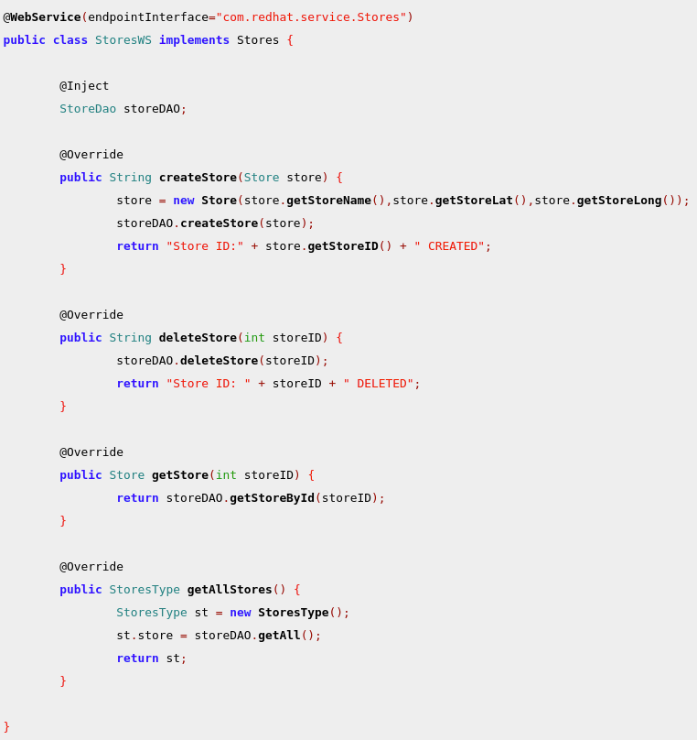
SOAP Code Example
Notes:
APIs are the language of digital business. It’s tough to find a company or organization these days that is not exposing APIs to users, customers, clients, and partners as part of their digital transformation. Examples of capabilities required for traditional API programs include:
Scale to large numbers of APIs and request volume
End-to-end security with TLS
Flexible deployment and traffic routing features to support A/B, Blue/Green, Canary deployments
Developer portal to engage and onboard API clients
Client authentication and authorization
Application-level policy control
Analytics
API management is typically used in “north south” architectures where API clients live beyond trust and/or organizational boundaries.
When adopting a next gen application platform for your enterprise, consider what support the platform has for these ‘table stakes’ requirements for an API program.

Slide 22
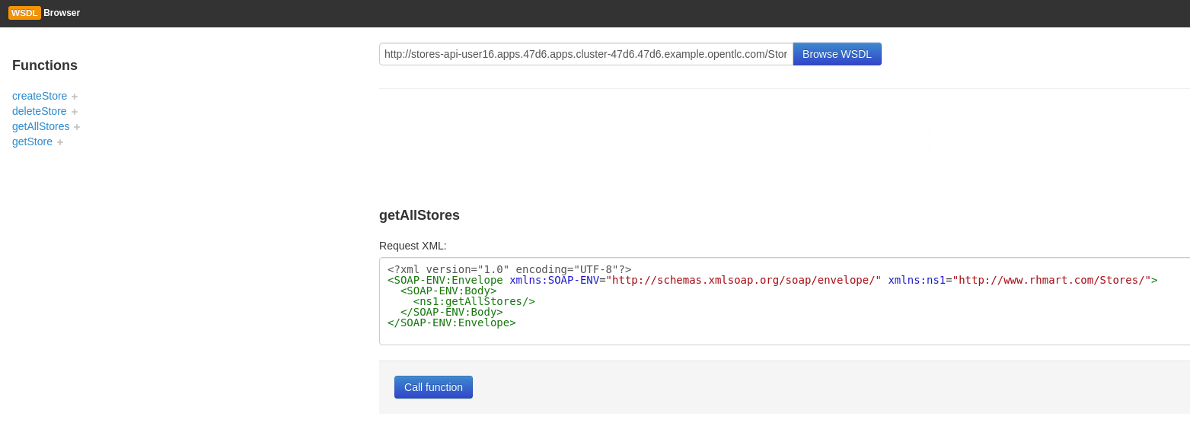
WSDL Browser
Notes:
APIs are the language of digital business. It’s tough to find a company or organization these days that is not exposing APIs to users, customers, clients, and partners as part of their digital transformation. Examples of capabilities required for traditional API programs include:
Scale to large numbers of APIs and request volume
End-to-end security with TLS
Flexible deployment and traffic routing features to support A/B, Blue/Green, Canary deployments
Developer portal to engage and onboard API clients
Client authentication and authorization
Application-level policy control
Analytics
API management is typically used in “north south” architectures where API clients live beyond trust and/or organizational boundaries.
When adopting a next gen application platform for your enterprise, consider what support the platform has for these ‘table stakes’ requirements for an API program.

Slide 23
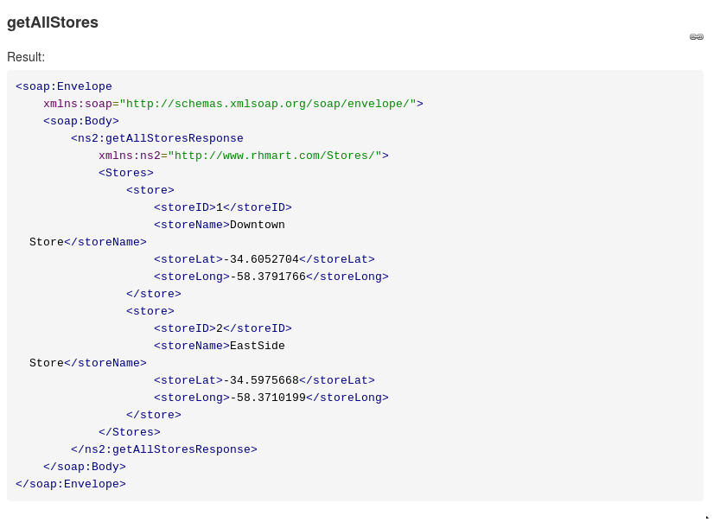
Notes:
APIs are the language of digital business. It’s tough to find a company or organization these days that is not exposing APIs to users, customers, clients, and partners as part of their digital transformation. Examples of capabilities required for traditional API programs include:
Scale to large numbers of APIs and request volume
End-to-end security with TLS
Flexible deployment and traffic routing features to support A/B, Blue/Green, Canary deployments
Developer portal to engage and onboard API clients
Client authentication and authorization
Application-level policy control
Analytics
API management is typically used in “north south” architectures where API clients live beyond trust and/or organizational boundaries.
When adopting a next gen application platform for your enterprise, consider what support the platform has for these ‘table stakes’ requirements for an API program.

Slide 24
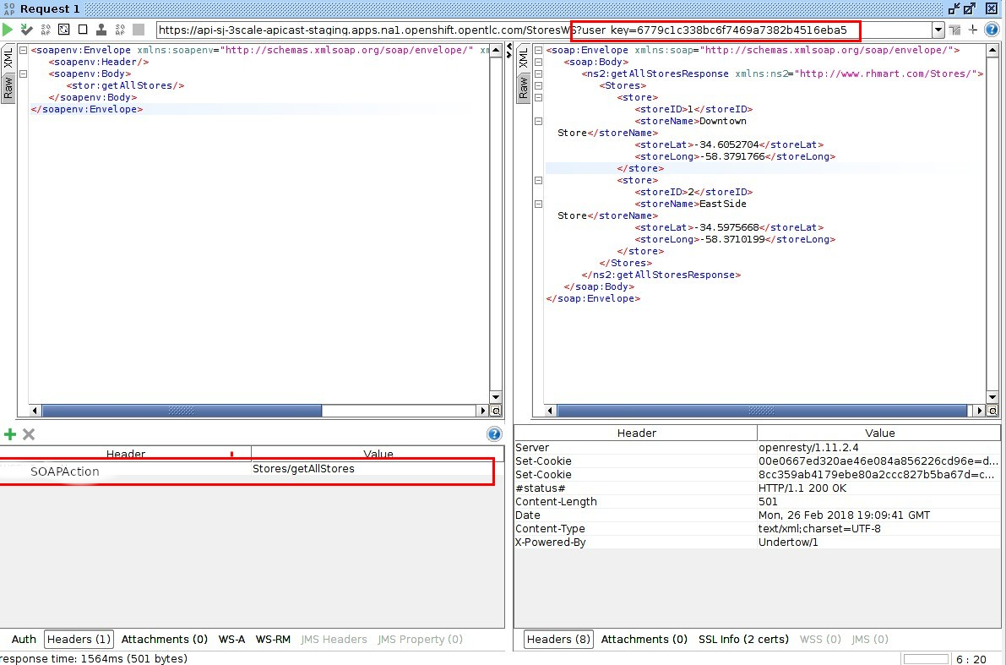
SOAP UI
Send SOAP requests
left - request
right - response
Better visibility of XML
Add header parameters
Notes:
APIs are the language of digital business. It’s tough to find a company or organization these days that is not exposing APIs to users, customers, clients, and partners as part of their digital transformation. Examples of capabilities required for traditional API programs include:
Scale to large numbers of APIs and request volume
End-to-end security with TLS
Flexible deployment and traffic routing features to support A/B, Blue/Green, Canary deployments
Developer portal to engage and onboard API clients
Client authentication and authorization
Application-level policy control
Analytics
API management is typically used in “north south” architectures where API clients live beyond trust and/or organizational boundaries.
When adopting a next gen application platform for your enterprise, consider what support the platform has for these ‘table stakes’ requirements for an API program.

Slide 25
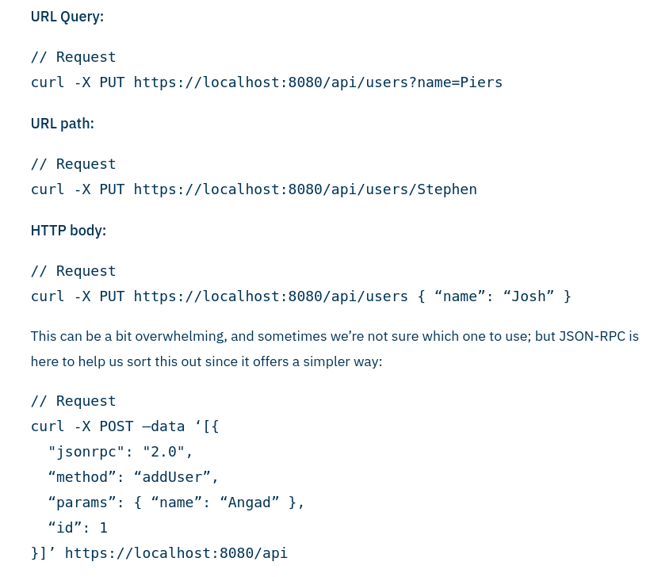
RPC Remote Procedure Call
RPC vs. REST
Specifications
Internal API’s parameters awareness
Query info transferred in the request’s data
Not relying solely on verbs (GET/POST, etc.)
Biggest Con of RPC
The sender need to be aware of the exact “serialization” of the payload and every information that relates to the specific method
One typo and you're out
Notes:
APIs are the language of digital business. It’s tough to find a company or organization these days that is not exposing APIs to users, customers, clients, and partners as part of their digital transformation. Examples of capabilities required for traditional API programs include:
Scale to large numbers of APIs and request volume
End-to-end security with TLS
Flexible deployment and traffic routing features to support A/B, Blue/Green, Canary deployments
Developer portal to engage and onboard API clients
Client authentication and authorization
Application-level policy control
Analytics
API management is typically used in “north south” architectures where API clients live beyond trust and/or organizational boundaries.
When adopting a next gen application platform for your enterprise, consider what support the platform has for these ‘table stakes’ requirements for an API program.

Slide 26
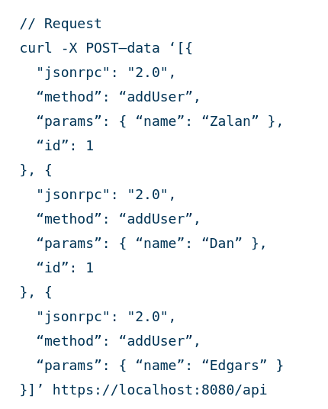
RPC Batch Actions
Batched action
RPC Pro
Batch actions
Less packets => Lower overhead => Increase performance
Notes:
APIs are the language of digital business. It’s tough to find a company or organization these days that is not exposing APIs to users, customers, clients, and partners as part of their digital transformation. Examples of capabilities required for traditional API programs include:
Scale to large numbers of APIs and request volume
End-to-end security with TLS
Flexible deployment and traffic routing features to support A/B, Blue/Green, Canary deployments
Developer portal to engage and onboard API clients
Client authentication and authorization
Application-level policy control
Analytics
API management is typically used in “north south” architectures where API clients live beyond trust and/or organizational boundaries.
When adopting a next gen application platform for your enterprise, consider what support the platform has for these ‘table stakes’ requirements for an API program.

Slide 27
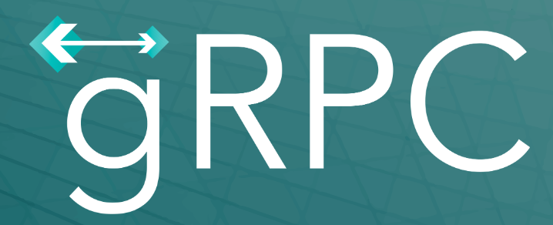
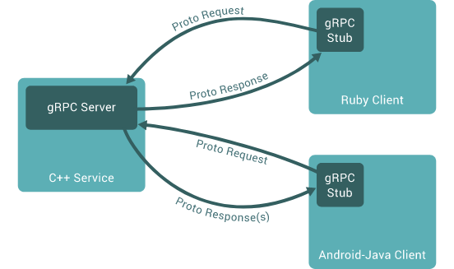
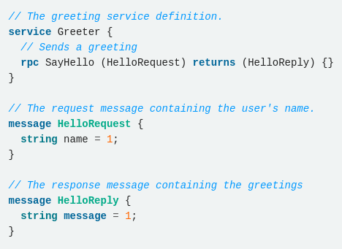
gRPC
Definitions all over! Solves RPC biggest con
3Scale 2.8+ Supports gRPC
Scalable, Fast, Works across multiple languages and platforms
https://grpc.io/docs/what-is-grpc/
Notes:
APIs are the language of digital business. It’s tough to find a company or organization these days that is not exposing APIs to users, customers, clients, and partners as part of their digital transformation. Examples of capabilities required for traditional API programs include:
Scale to large numbers of APIs and request volume
End-to-end security with TLS
Flexible deployment and traffic routing features to support A/B, Blue/Green, Canary deployments
Developer portal to engage and onboard API clients
Client authentication and authorization
Application-level policy control
Analytics
API management is typically used in “north south” architectures where API clients live beyond trust and/or organizational boundaries.
When adopting a next gen application platform for your enterprise, consider what support the platform has for these ‘table stakes’ requirements for an API program.

Slide 28

GraphQL
The best explanation is an example - https://graphql.org/
One - to - Many API Query tool
Graphql vs. REST - Medium Blog
Currently not supported by 3Scale (Future Feature)
Notes:
APIs are the language of digital business. It’s tough to find a company or organization these days that is not exposing APIs to users, customers, clients, and partners as part of their digital transformation. Examples of capabilities required for traditional API programs include:
Scale to large numbers of APIs and request volume
End-to-end security with TLS
Flexible deployment and traffic routing features to support A/B, Blue/Green, Canary deployments
Developer portal to engage and onboard API clients
Client authentication and authorization
Application-level policy control
Analytics
API management is typically used in “north south” architectures where API clients live beyond trust and/or organizational boundaries.
When adopting a next gen application platform for your enterprise, consider what support the platform has for these ‘table stakes’ requirements for an API program.

Slide 29
Get Your Hands Dirty
Requirements:
OCP client (oc), python, jq
Optionally use an IDE (such as VS Code) to view files
Exercise 1
Notes:
APIs are the language of digital business. It’s tough to find a company or organization these days that is not exposing APIs to users, customers, clients, and partners as part of their digital transformation. Examples of capabilities required for traditional API programs include:
Scale to large numbers of APIs and request volume
End-to-end security with TLS
Flexible deployment and traffic routing features to support A/B, Blue/Green, Canary deployments
Developer portal to engage and onboard API clients
Client authentication and authorization
Application-level policy control
Analytics
API management is typically used in “north south” architectures where API clients live beyond trust and/or organizational boundaries.
When adopting a next gen application platform for your enterprise, consider what support the platform has for these ‘table stakes’ requirements for an API program.

Slide 30
RED HAT AGILE INTEGRATION

Slide 31
FULL API LIFECYCLE MANAGEMENT
7. Secure
8. Manage
13. Monetize
6. Deploy
12. Monitor
5. Implement
11. Consume
1. Strategy
4. Test
3. Mock
2. Design
9. Discover
10. Develop
Notes:
APIs are the language of digital business. It’s tough to find a company or organization these days that is not exposing APIs to users, customers, clients, and partners as part of their digital transformation. Examples of capabilities required for traditional API programs include:
Scale to large numbers of APIs and request volume
End-to-end security with TLS
Flexible deployment and traffic routing features to support A/B, Blue/Green, Canary deployments
Developer portal to engage and onboard API clients
Client authentication and authorization
Application-level policy control
Analytics
API management is typically used in “north south” architectures where API clients live beyond trust and/or organizational boundaries.
When adopting a next gen application platform for your enterprise, consider what support the platform has for these ‘table stakes’ requirements for an API program.

Slide 32
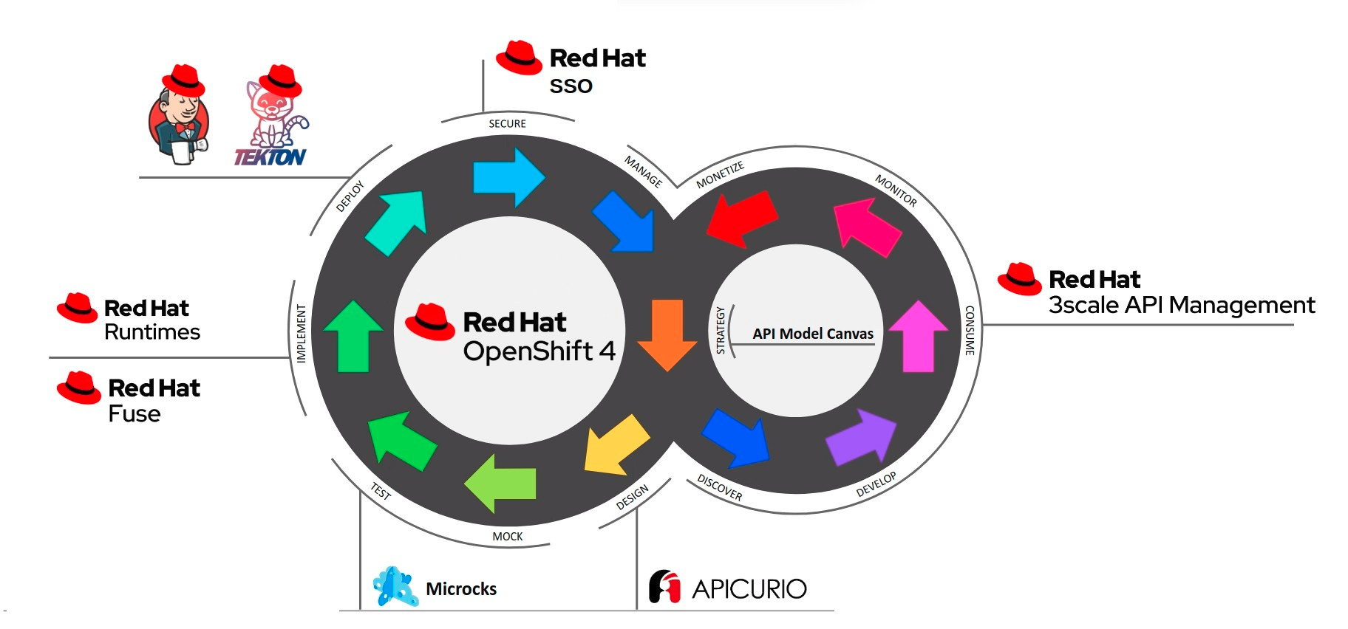
API LIFECYCLE AND STACK - OCP 4.x
Notes:
APIs are the language of digital business. It’s tough to find a company or organization these days that is not exposing APIs to users, customers, clients, and partners as part of their digital transformation. Examples of capabilities required for traditional API programs include:
Scale to large numbers of APIs and request volume
End-to-end security with TLS
Flexible deployment and traffic routing features to support A/B, Blue/Green, Canary deployments
Developer portal to engage and onboard API clients
Client authentication and authorization
Application-level policy control
Analytics
API management is typically used in “north south” architectures where API clients live beyond trust and/or organizational boundaries.
When adopting a next gen application platform for your enterprise, consider what support the platform has for these ‘table stakes’ requirements for an API program.

Slide 33
Most Common Implementation for API GW
Client
Gateway
APIs as a digital access point for your business
“North-South” service architecture pattern
Requires traditional API management capabilities
APIs As A Product
API
API
Notes:
APIs are the language of digital business. It’s tough to find a company or organization these days that is not exposing APIs to users, customers, clients, and partners as part of their digital transformation. Examples of capabilities required for traditional API programs include:
Scale to large numbers of APIs and request volume
End-to-end security with TLS
Flexible deployment and traffic routing features to support A/B, Blue/Green, Canary deployments
Developer portal to engage and onboard API clients
Client authentication and authorization
Application-level policy control
Analytics
API management is typically used in “north south” architectures where API clients live beyond trust and/or organizational boundaries.
When adopting a next gen application platform for your enterprise, consider what support the platform has for these ‘table stakes’ requirements for an API program.

Slide 34
Red Hat 3Scale Overview & Basic Architecture

Slide 35

RED HAT 3SCALE API MANAGEMENT
100% Open Source
Modular
No single point of failure
Quick time-to-value
Highly scalable
Support Multi Tenancy
Support Remote-Implementation Options
My Medium Articles API Management Overview Installation Guide
Notes:
APIs are the language of digital business. It’s tough to find a company or organization these days that is not exposing APIs to users, customers, clients, and partners as part of their digital transformation. Examples of capabilities required for traditional API programs include:
Scale to large numbers of APIs and request volume
End-to-end security with TLS
Flexible deployment and traffic routing features to support A/B, Blue/Green, Canary deployments
Developer portal to engage and onboard API clients
Client authentication and authorization
Application-level policy control
Analytics
API management is typically used in “north south” architectures where API clients live beyond trust and/or organizational boundaries.
When adopting a next gen application platform for your enterprise, consider what support the platform has for these ‘table stakes’ requirements for an API program.

Slide 36
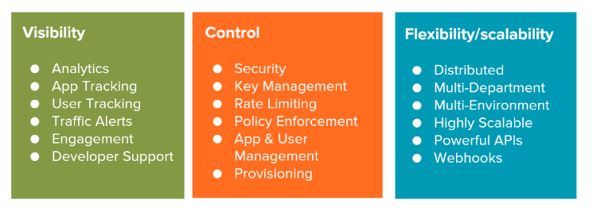
API Management Main Disciplines
Notes:
APIs are the language of digital business. It’s tough to find a company or organization these days that is not exposing APIs to users, customers, clients, and partners as part of their digital transformation. Examples of capabilities required for traditional API programs include:
Scale to large numbers of APIs and request volume
End-to-end security with TLS
Flexible deployment and traffic routing features to support A/B, Blue/Green, Canary deployments
Developer portal to engage and onboard API clients
Client authentication and authorization
Application-level policy control
Analytics
API management is typically used in “north south” architectures where API clients live beyond trust and/or organizational boundaries.
When adopting a next gen application platform for your enterprise, consider what support the platform has for these ‘table stakes’ requirements for an API program.

Slide 37
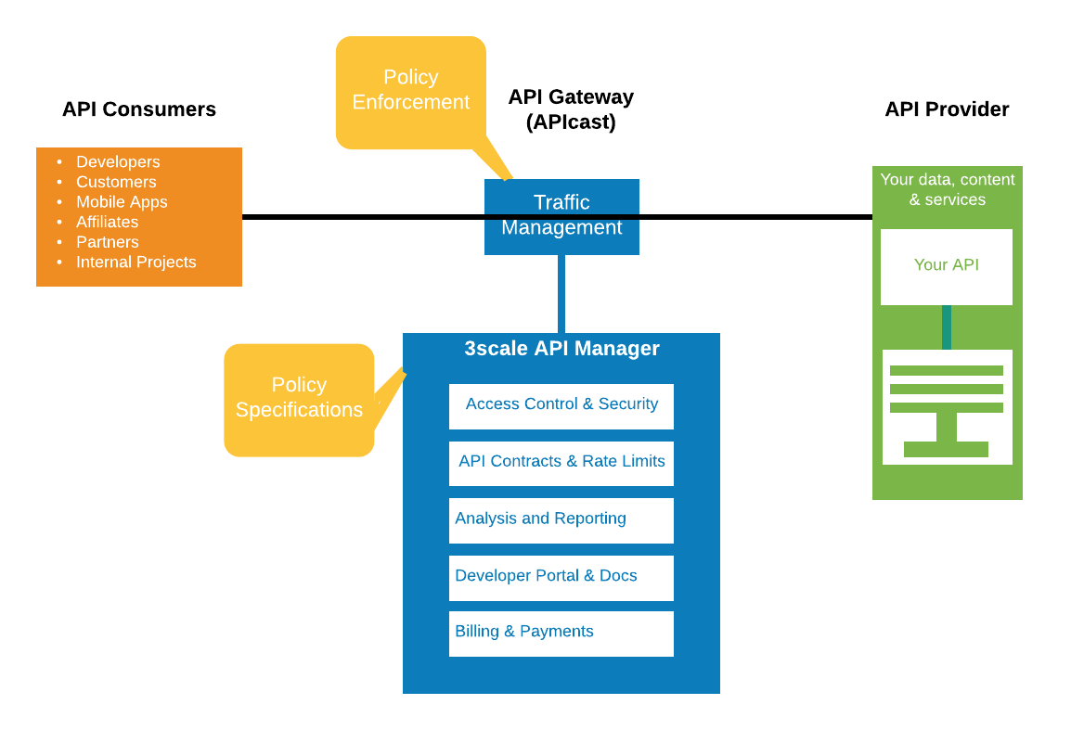
Terminology
Notes:
APIs are the language of digital business. It’s tough to find a company or organization these days that is not exposing APIs to users, customers, clients, and partners as part of their digital transformation. Examples of capabilities required for traditional API programs include:
Scale to large numbers of APIs and request volume
End-to-end security with TLS
Flexible deployment and traffic routing features to support A/B, Blue/Green, Canary deployments
Developer portal to engage and onboard API clients
Client authentication and authorization
Application-level policy control
Analytics
API management is typically used in “north south” architectures where API clients live beyond trust and/or organizational boundaries.
When adopting a next gen application platform for your enterprise, consider what support the platform has for these ‘table stakes’ requirements for an API program.

Slide 38
Multiple Usage Types
Internal Developers
Subscription Plans
3Scale Admins
Product Management, Deployment & Scaling
App Client - Mobile/Browser
Account Plans
External Companies - Developers
Customizable Developer Portal
Monetization
Also relevant for integration between internal services (East-West)
Notes:
APIs are the language of digital business. It’s tough to find a company or organization these days that is not exposing APIs to users, customers, clients, and partners as part of their digital transformation. Examples of capabilities required for traditional API programs include:
Scale to large numbers of APIs and request volume
End-to-end security with TLS
Flexible deployment and traffic routing features to support A/B, Blue/Green, Canary deployments
Developer portal to engage and onboard API clients
Client authentication and authorization
Application-level policy control
Analytics
API management is typically used in “north south” architectures where API clients live beyond trust and/or organizational boundaries.
When adopting a next gen application platform for your enterprise, consider what support the platform has for these ‘table stakes’ requirements for an API program.

Slide 39
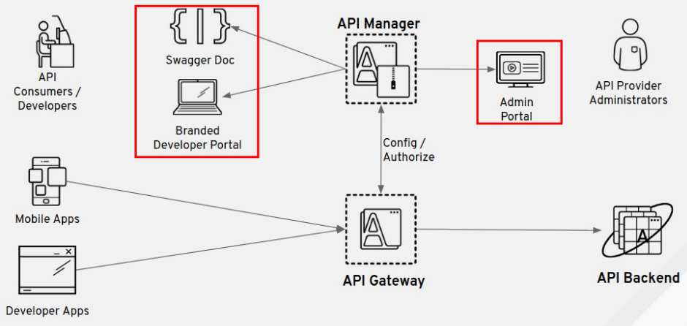
Complete Diagram
Notes:
APIs are the language of digital business. It’s tough to find a company or organization these days that is not exposing APIs to users, customers, clients, and partners as part of their digital transformation. Examples of capabilities required for traditional API programs include:
Scale to large numbers of APIs and request volume
End-to-end security with TLS
Flexible deployment and traffic routing features to support A/B, Blue/Green, Canary deployments
Developer portal to engage and onboard API clients
Client authentication and authorization
Application-level policy control
Analytics
API management is typically used in “north south” architectures where API clients live beyond trust and/or organizational boundaries.
When adopting a next gen application platform for your enterprise, consider what support the platform has for these ‘table stakes’ requirements for an API program.

Slide 40


API MANAGEMENT vs. LIFECYCLE
LIFECYCLE
Testing
Release
Versions
Deployment
SLA
MANAGEMENT
CONTROL
VISIBILITY
Security
Key management
Rate limiting
Policy enforcement
User management
Provisioning
Analytics
App tracking
User tracking
Traffic alerts
Engagement
Developer support
Notes:
APIs are the language of digital business. It’s tough to find a company or organization these days that is not exposing APIs to users, customers, clients, and partners as part of their digital transformation. Examples of capabilities required for traditional API programs include:
Scale to large numbers of APIs and request volume
End-to-end security with TLS
Flexible deployment and traffic routing features to support A/B, Blue/Green, Canary deployments
Developer portal to engage and onboard API clients
Client authentication and authorization
Application-level policy control
Analytics
API management is typically used in “north south” architectures where API clients live beyond trust and/or organizational boundaries.
When adopting a next gen application platform for your enterprise, consider what support the platform has for these ‘table stakes’ requirements for an API program.

Slide 41


3Scale Components
API Gateway (apicast-*)
API Manager
System (system-*)
redis
mysql
memcache
sphinx
sidekiq
app
developer
production
staging
Backend (backend-*)
Security (zync-*)
redis
cron
worker
listener
zync
database
Supported Configuration
Notes:
APIs are the language of digital business. It’s tough to find a company or organization these days that is not exposing APIs to users, customers, clients, and partners as part of their digital transformation. Examples of capabilities required for traditional API programs include:
Scale to large numbers of APIs and request volume
End-to-end security with TLS
Flexible deployment and traffic routing features to support A/B, Blue/Green, Canary deployments
Developer portal to engage and onboard API clients
Client authentication and authorization
Application-level policy control
Analytics
API management is typically used in “north south” architectures where API clients live beyond trust and/or organizational boundaries.
When adopting a next gen application platform for your enterprise, consider what support the platform has for these ‘table stakes’ requirements for an API program.

Slide 42
RED HAT 3SCALE API MANAGEMENT
Storage Requirements
3 or 4 Persistent Volumes
3 RWO PV for Redis and MySQL/Postgres persistence (always needed)
1 RWX PV (amp.yml template) MUST be group writable: chmod g+w
or
AWS S3 Bucket for CMS assets (amp-s3.yml template)
10GB storage should be plenty to get started, 30GB for Production
PVs should be writeable by OpenShift (Permissions)
Owned by root group
Proper selinux permissions: chcon -Rt svirt_sandbox_file_t
Supported Configuration - Update Periodically
Notes:
APIs are the language of digital business. It’s tough to find a company or organization these days that is not exposing APIs to users, customers, clients, and partners as part of their digital transformation. Examples of capabilities required for traditional API programs include:
Scale to large numbers of APIs and request volume
End-to-end security with TLS
Flexible deployment and traffic routing features to support A/B, Blue/Green, Canary deployments
Developer portal to engage and onboard API clients
Client authentication and authorization
Application-level policy control
Analytics
API management is typically used in “north south” architectures where API clients live beyond trust and/or organizational boundaries.
When adopting a next gen application platform for your enterprise, consider what support the platform has for these ‘table stakes’ requirements for an API program.

Slide 43
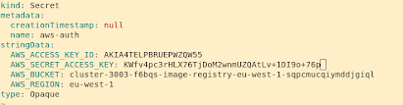
Deploy 3Scale with S3 using Operator
Link to Documentation
The RHPDS lab environment runs on AWS managed, which means that it has credentials for the aws bucket for the internal registry, and I used them to deploy 3scale on the same storage
oc describe configs.imageregistry.operator.openshift.io cluster | grep “Bucket:”
oc describe configs.imageregistry.operator.openshift.io cluster | grep "Region:"
oc extract secret/installer-cloud-credentials -n openshift-image-registry --to=--
Note! You won’t see a PVC ‘system-storage’, unlike with the other option (NFS)
Notes:
APIs are the language of digital business. It’s tough to find a company or organization these days that is not exposing APIs to users, customers, clients, and partners as part of their digital transformation. Examples of capabilities required for traditional API programs include:
Scale to large numbers of APIs and request volume
End-to-end security with TLS
Flexible deployment and traffic routing features to support A/B, Blue/Green, Canary deployments
Developer portal to engage and onboard API clients
Client authentication and authorization
Application-level policy control
Analytics
API management is typically used in “north south” architectures where API clients live beyond trust and/or organizational boundaries.
When adopting a next gen application platform for your enterprise, consider what support the platform has for these ‘table stakes’ requirements for an API program.

Slide 44
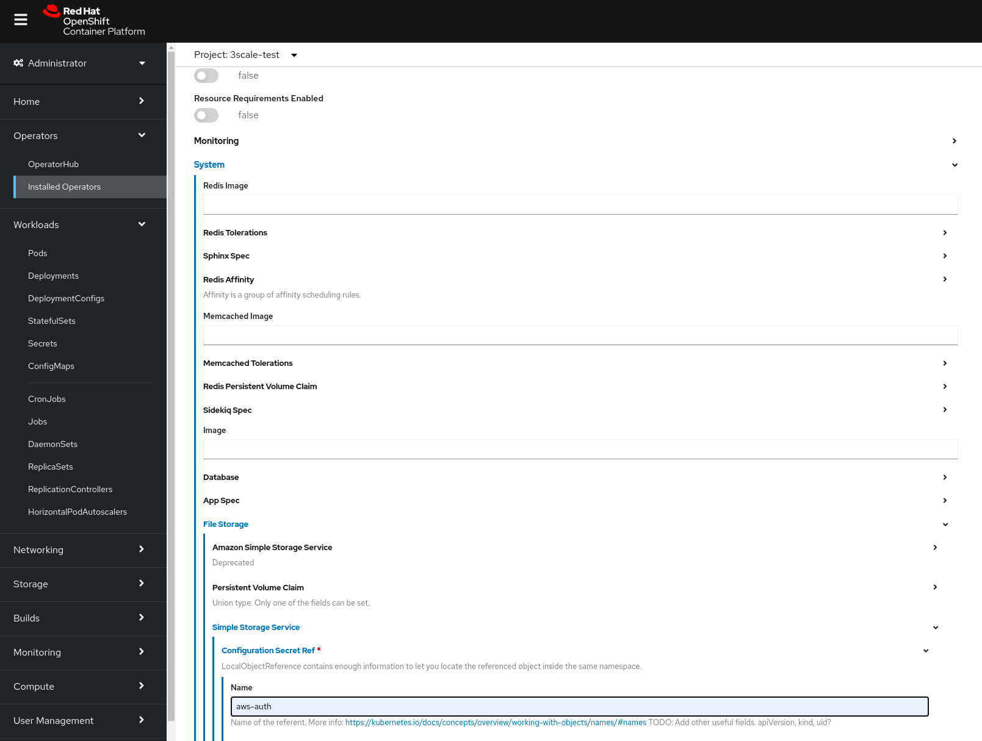
Notes:
APIs are the language of digital business. It’s tough to find a company or organization these days that is not exposing APIs to users, customers, clients, and partners as part of their digital transformation. Examples of capabilities required for traditional API programs include:
Scale to large numbers of APIs and request volume
End-to-end security with TLS
Flexible deployment and traffic routing features to support A/B, Blue/Green, Canary deployments
Developer portal to engage and onboard API clients
Client authentication and authorization
Application-level policy control
Analytics
API management is typically used in “north south” architectures where API clients live beyond trust and/or organizational boundaries.
When adopting a next gen application platform for your enterprise, consider what support the platform has for these ‘table stakes’ requirements for an API program.

Slide 45
APIcast (API Gateway)
NGINX - Web Proxy
Lua - Built-in & Custom Policies
OpenResty - Modules to support in various protocols
Notes:
APIs are the language of digital business. It’s tough to find a company or organization these days that is not exposing APIs to users, customers, clients, and partners as part of their digital transformation. Examples of capabilities required for traditional API programs include:
Scale to large numbers of APIs and request volume
End-to-end security with TLS
Flexible deployment and traffic routing features to support A/B, Blue/Green, Canary deployments
Developer portal to engage and onboard API clients
Client authentication and authorization
Application-level policy control
Analytics
API management is typically used in “north south” architectures where API clients live beyond trust and/or organizational boundaries.
When adopting a next gen application platform for your enterprise, consider what support the platform has for these ‘table stakes’ requirements for an API program.

Slide 46
Supported API Protocols
REST API (inc. HTTP 2)
APICast Policies
Simple SOAP (Can be extended with RH Fuse)
gRPC
WebSocket
Graphql, other RPC protocols - Not supported
Other protocols (Tcp etc.) - built-in/custom policies, RH-Fuse
Notes:
APIs are the language of digital business. It’s tough to find a company or organization these days that is not exposing APIs to users, customers, clients, and partners as part of their digital transformation. Examples of capabilities required for traditional API programs include:
Scale to large numbers of APIs and request volume
End-to-end security with TLS
Flexible deployment and traffic routing features to support A/B, Blue/Green, Canary deployments
Developer portal to engage and onboard API clients
Client authentication and authorization
Application-level policy control
Analytics
API management is typically used in “north south” architectures where API clients live beyond trust and/or organizational boundaries.
When adopting a next gen application platform for your enterprise, consider what support the platform has for these ‘table stakes’ requirements for an API program.

Slide 47
3Scale Technical Glossary

Slide 48

Backend - Internal Service
Product - Externally exposed Service via APICast
Method mapping - permit access to specific endpoint-functions
Metrics - Counting hits to endpoint-functions
Notes:
APIs are the language of digital business. It’s tough to find a company or organization these days that is not exposing APIs to users, customers, clients, and partners as part of their digital transformation. Examples of capabilities required for traditional API programs include:
Scale to large numbers of APIs and request volume
End-to-end security with TLS
Flexible deployment and traffic routing features to support A/B, Blue/Green, Canary deployments
Developer portal to engage and onboard API clients
Client authentication and authorization
Application-level policy control
Analytics
API management is typically used in “north south” architectures where API clients live beyond trust and/or organizational boundaries.
When adopting a next gen application platform for your enterprise, consider what support the platform has for these ‘table stakes’ requirements for an API program.

Slide 49
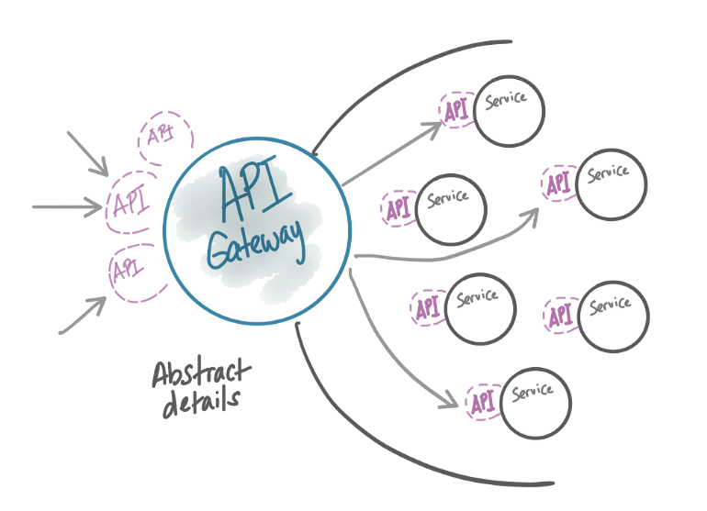
Products & Backends association
Notes:
APIs are the language of digital business. It’s tough to find a company or organization these days that is not exposing APIs to users, customers, clients, and partners as part of their digital transformation. Examples of capabilities required for traditional API programs include:
Scale to large numbers of APIs and request volume
End-to-end security with TLS
Flexible deployment and traffic routing features to support A/B, Blue/Green, Canary deployments
Developer portal to engage and onboard API clients
Client authentication and authorization
Application-level policy control
Analytics
API management is typically used in “north south” architectures where API clients live beyond trust and/or organizational boundaries.
When adopting a next gen application platform for your enterprise, consider what support the platform has for these ‘table stakes’ requirements for an API program.

Slide 50



API Products & API Backends
API Product
public/managed
API Backend
private
Business layer
Technical layer
Public facing (“facade”) → URL structures
Can use multiple API backends
Sign-up → API creds → AuthN
App plans = limits and pricing rules
(Global) metrics/mapping rules
APIcast policies
Gateway
Private base URL
Can be used by multiple API products
(Local) metrics/mapping rules (by method)
Path-based routing
Notes:
APIs are the language of digital business. It’s tough to find a company or organization these days that is not exposing APIs to users, customers, clients, and partners as part of their digital transformation. Examples of capabilities required for traditional API programs include:
Scale to large numbers of APIs and request volume
End-to-end security with TLS
Flexible deployment and traffic routing features to support A/B, Blue/Green, Canary deployments
Developer portal to engage and onboard API clients
Client authentication and authorization
Application-level policy control
Analytics
API management is typically used in “north south” architectures where API clients live beyond trust and/or organizational boundaries.
When adopting a next gen application platform for your enterprise, consider what support the platform has for these ‘table stakes’ requirements for an API program.

Slide 51
Take another look, Just for the sake of it
Notes:
APIs are the language of digital business. It’s tough to find a company or organization these days that is not exposing APIs to users, customers, clients, and partners as part of their digital transformation. Examples of capabilities required for traditional API programs include:
Scale to large numbers of APIs and request volume
End-to-end security with TLS
Flexible deployment and traffic routing features to support A/B, Blue/Green, Canary deployments
Developer portal to engage and onboard API clients
Client authentication and authorization
Application-level policy control
Analytics
API management is typically used in “north south” architectures where API clients live beyond trust and/or organizational boundaries.
When adopting a next gen application platform for your enterprise, consider what support the platform has for these ‘table stakes’ requirements for an API program.

Slide 52
Mapping Rules 101
Backend-level
Mapping Rules
Basic: GET /page
Wildcard: GET /frontpage/{version}
Exact Match: GET /wow$
Passing values: From URL: GET /something?example_value={value} Or From Body: POST/PUT/DELETE /something?another_example_value={value}
Product-level
Mapping Rules
Note! More than one mapping rule can match the request path, but if none matches, the request is discarded with an HTTP 404 status code.
Notes:
APIs are the language of digital business. It’s tough to find a company or organization these days that is not exposing APIs to users, customers, clients, and partners as part of their digital transformation. Examples of capabilities required for traditional API programs include:
Scale to large numbers of APIs and request volume
End-to-end security with TLS
Flexible deployment and traffic routing features to support A/B, Blue/Green, Canary deployments
Developer portal to engage and onboard API clients
Client authentication and authorization
Application-level policy control
Analytics
API management is typically used in “north south” architectures where API clients live beyond trust and/or organizational boundaries.
When adopting a next gen application platform for your enterprise, consider what support the platform has for these ‘table stakes’ requirements for an API program.

Slide 53
Mapping Rules
Product-level
Mapping Rules
Backend-level
Mapping Rules
Evaluated after Product-level MRs
Evaluated only if the traffic is being routed to the same Backend the Mapping Rule belongs to
Same set of MRs exists in all Products using the Backend
The path of the Backend in a given Product is automatically and transparently prepended to each MR of the Backend in that Product
Take precedence – i.e. go on top of all MRs
Always evaluated, no matter to which Backend the traffic will be routed
Notes:
APIs are the language of digital business. It’s tough to find a company or organization these days that is not exposing APIs to users, customers, clients, and partners as part of their digital transformation. Examples of capabilities required for traditional API programs include:
Scale to large numbers of APIs and request volume
End-to-end security with TLS
Flexible deployment and traffic routing features to support A/B, Blue/Green, Canary deployments
Developer portal to engage and onboard API clients
Client authentication and authorization
Application-level policy control
Analytics
API management is typically used in “north south” architectures where API clients live beyond trust and/or organizational boundaries.
When adopting a next gen application platform for your enterprise, consider what support the platform has for these ‘table stakes’ requirements for an API program.

Slide 54
Methods & Metrics
Backend-level
Mapping Rules
Product-level
Mapping Rules
Backend-level
Method & Metrics
Product-level
Methods & Metrics
“Hits” metric counts hits mapped to “Hits” itself and to its methods + the hits mapped to all Backend-level “Hits” metrics and their methods.
Registered in Apisonator as if they belonged to each Product using the Backend
Automatically and transparently get the ID of the Backend appended to the system_name of the metric
Limits and Pricing rules can be set upon Backend-level metrics in the Application Plans at the Product level
Notes:
APIs are the language of digital business. It’s tough to find a company or organization these days that is not exposing APIs to users, customers, clients, and partners as part of their digital transformation. Examples of capabilities required for traditional API programs include:
Scale to large numbers of APIs and request volume
End-to-end security with TLS
Flexible deployment and traffic routing features to support A/B, Blue/Green, Canary deployments
Developer portal to engage and onboard API clients
Client authentication and authorization
Application-level policy control
Analytics
API management is typically used in “north south” architectures where API clients live beyond trust and/or organizational boundaries.
When adopting a next gen application platform for your enterprise, consider what support the platform has for these ‘table stakes’ requirements for an API program.

Slide 55
Complete Example - Expose APIs via 3Scale
Starting with the backend and then associating them with the products
Tracking (ID=12) | wss://tracking/api/v1
Shipping | https://shipping.company.com
Shipping prices | https://shipping-prices.api
Mapping rules
Backends
Backends
GET /packages
hits.12
/track
Tracking
/
Logistics
POST /packages
/gds
Logistics
hits.12
Mapping rules
Mapping rules
GET /packages/{id}
hits.12
GET /track/packages
GET /fares
hits.12
fares.13
From
From
Logistics
POST /track/packages
hits.12
Tracking
POST /quotations
quotes.13
Logistics (ID=13) | https://gds.log/api
GET /track/packages/{id}
hits.12
GET /gds/fares
fares.13
From
GET https://shipping-prices.api/fares→ https://gds.log/api/fares
POST https://shipping-prices.api/quotations → https://gds.log/api/quotations
Mapping rules
POST /gds/quotations
Logistics
quotes.13
GET /fares
fares.13
POST /quotations
POST /{ns}/{collection}
new-objs
Product-level
quotes.13
POST https://shipping.company.com/track/packages → wss://tracking/api/v1/packages
GET https://shipping.company.com/gds/fares → https://gds.log/api/fares
Notes:
APIs are the language of digital business. It’s tough to find a company or organization these days that is not exposing APIs to users, customers, clients, and partners as part of their digital transformation. Examples of capabilities required for traditional API programs include:
Scale to large numbers of APIs and request volume
End-to-end security with TLS
Flexible deployment and traffic routing features to support A/B, Blue/Green, Canary deployments
Developer portal to engage and onboard API clients
Client authentication and authorization
Application-level policy control
Analytics
API management is typically used in “north south” architectures where API clients live beyond trust and/or organizational boundaries.
When adopting a next gen application platform for your enterprise, consider what support the platform has for these ‘table stakes’ requirements for an API program.

Slide 56
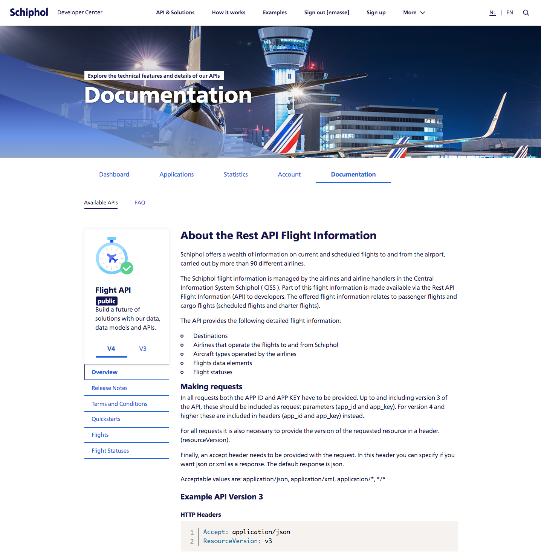
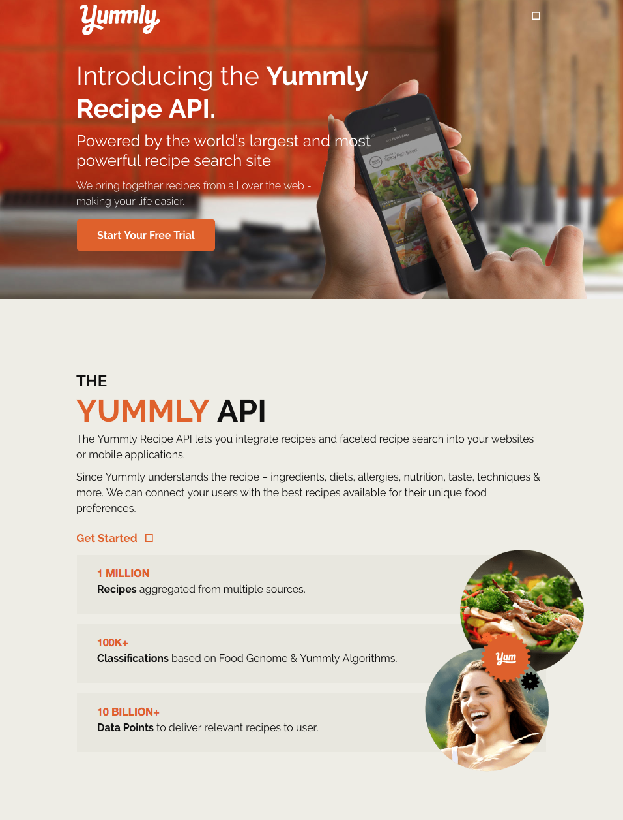
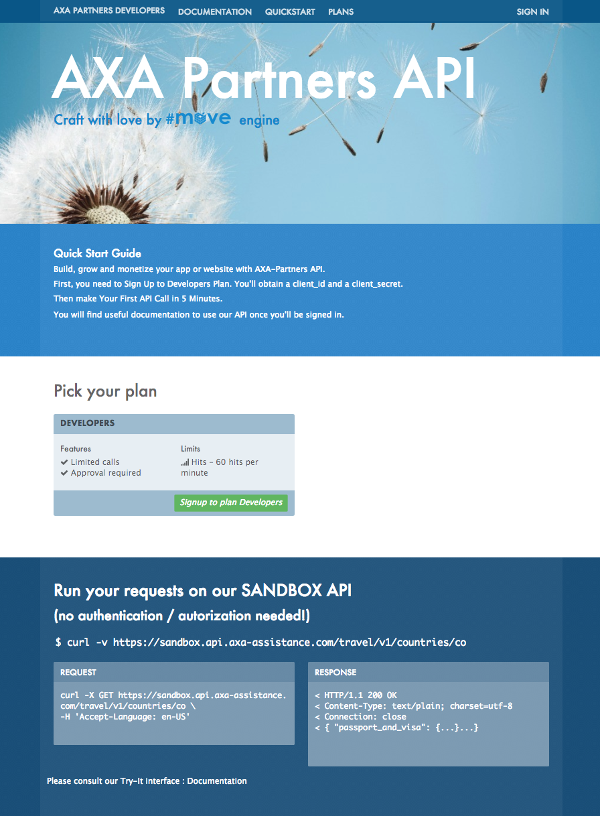
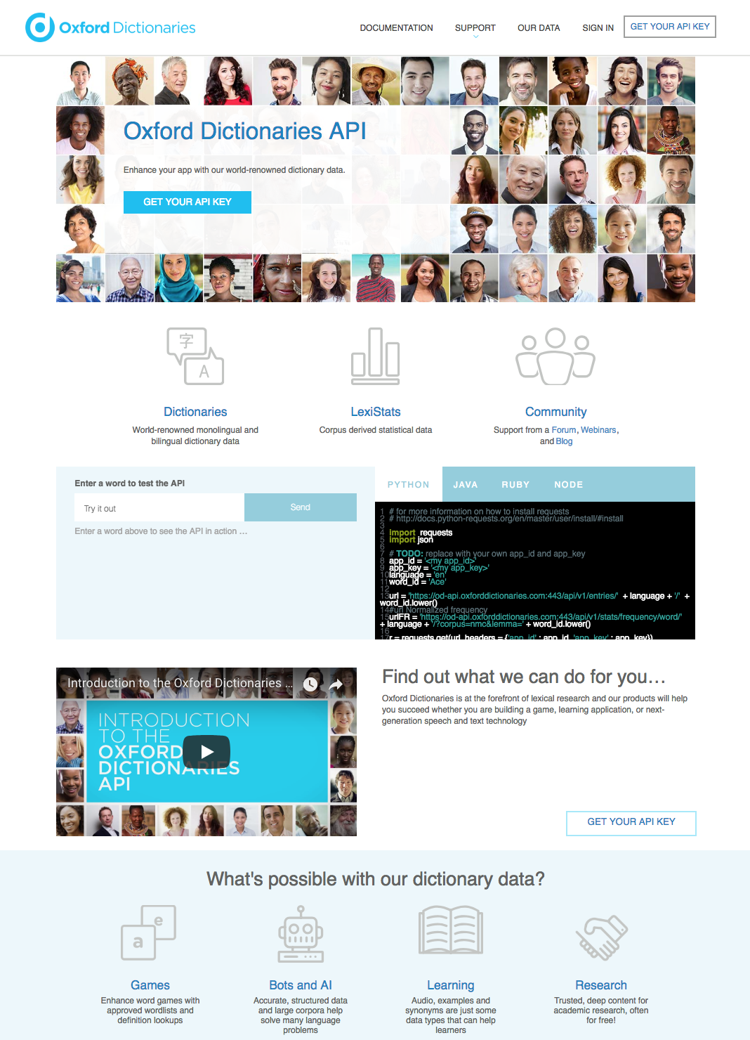
DEVELOPER & PARTNER PORTAL
Notes:
APIs are the language of digital business. It’s tough to find a company or organization these days that is not exposing APIs to users, customers, clients, and partners as part of their digital transformation. Examples of capabilities required for traditional API programs include:
Scale to large numbers of APIs and request volume
End-to-end security with TLS
Flexible deployment and traffic routing features to support A/B, Blue/Green, Canary deployments
Developer portal to engage and onboard API clients
Client authentication and authorization
Application-level policy control
Analytics
API management is typically used in “north south” architectures where API clients live beyond trust and/or organizational boundaries.
When adopting a next gen application platform for your enterprise, consider what support the platform has for these ‘table stakes’ requirements for an API program.

Slide 57

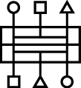
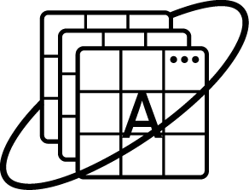
Most Basic & Common Scenario HTTP/S Web Services Endpoints
Developer Apps
Relevant Use-Cases
Service is already a HTTP REST / Simple SOAP Endpoint
Needs to implement access control and security
Direct routing to service implementation
API Gateway
API Backend
Notes:
APIs are the language of digital business. It’s tough to find a company or organization these days that is not exposing APIs to users, customers, clients, and partners as part of their digital transformation. Examples of capabilities required for traditional API programs include:
Scale to large numbers of APIs and request volume
End-to-end security with TLS
Flexible deployment and traffic routing features to support A/B, Blue/Green, Canary deployments
Developer portal to engage and onboard API clients
Client authentication and authorization
Application-level policy control
Analytics
API management is typically used in “north south” architectures where API clients live beyond trust and/or organizational boundaries.
When adopting a next gen application platform for your enterprise, consider what support the platform has for these ‘table stakes’ requirements for an API program.

Slide 58
Give it a try
Exercise #2
Notes:
APIs are the language of digital business. It’s tough to find a company or organization these days that is not exposing APIs to users, customers, clients, and partners as part of their digital transformation. Examples of capabilities required for traditional API programs include:
Scale to large numbers of APIs and request volume
End-to-end security with TLS
Flexible deployment and traffic routing features to support A/B, Blue/Green, Canary deployments
Developer portal to engage and onboard API clients
Client authentication and authorization
Application-level policy control
Analytics
API management is typically used in “north south” architectures where API clients live beyond trust and/or organizational boundaries.
When adopting a next gen application platform for your enterprise, consider what support the platform has for these ‘table stakes’ requirements for an API program.

Slide 59
Features Features Features

Slide 60
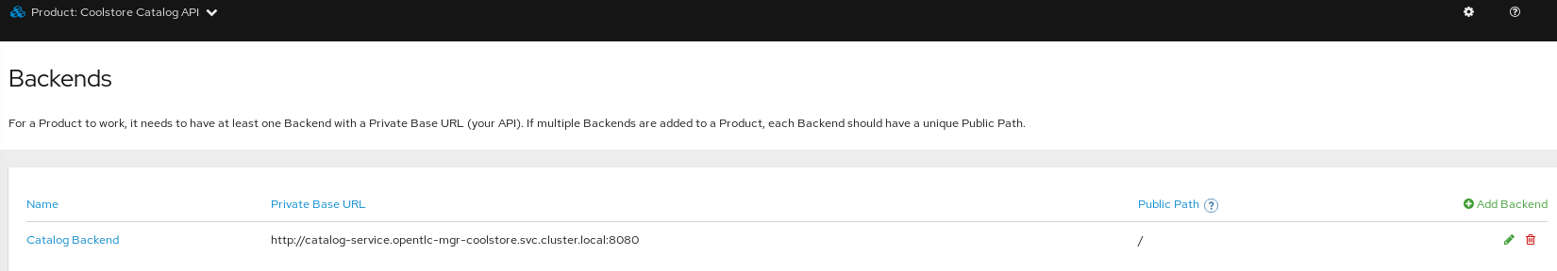
Multiple Backends per-APICast
Notes:
APIs are the language of digital business. It’s tough to find a company or organization these days that is not exposing APIs to users, customers, clients, and partners as part of their digital transformation. Examples of capabilities required for traditional API programs include:
Scale to large numbers of APIs and request volume
End-to-end security with TLS
Flexible deployment and traffic routing features to support A/B, Blue/Green, Canary deployments
Developer portal to engage and onboard API clients
Client authentication and authorization
Application-level policy control
Analytics
API management is typically used in “north south” architectures where API clients live beyond trust and/or organizational boundaries.
When adopting a next gen application platform for your enterprise, consider what support the platform has for these ‘table stakes’ requirements for an API program.

Slide 61
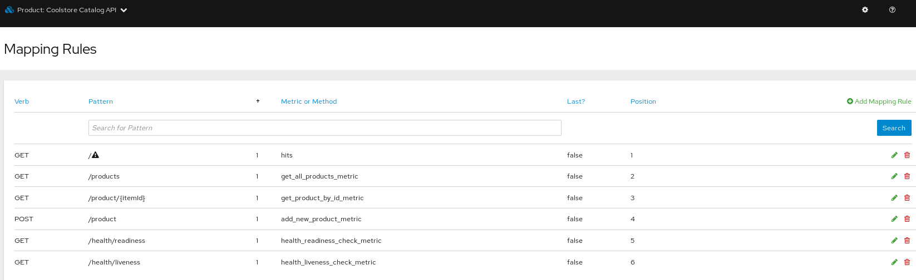
Mapping Rules & Wildcards
Notes:
APIs are the language of digital business. It’s tough to find a company or organization these days that is not exposing APIs to users, customers, clients, and partners as part of their digital transformation. Examples of capabilities required for traditional API programs include:
Scale to large numbers of APIs and request volume
End-to-end security with TLS
Flexible deployment and traffic routing features to support A/B, Blue/Green, Canary deployments
Developer portal to engage and onboard API clients
Client authentication and authorization
Application-level policy control
Analytics
API management is typically used in “north south” architectures where API clients live beyond trust and/or organizational boundaries.
When adopting a next gen application platform for your enterprise, consider what support the platform has for these ‘table stakes’ requirements for an API program.

Slide 62
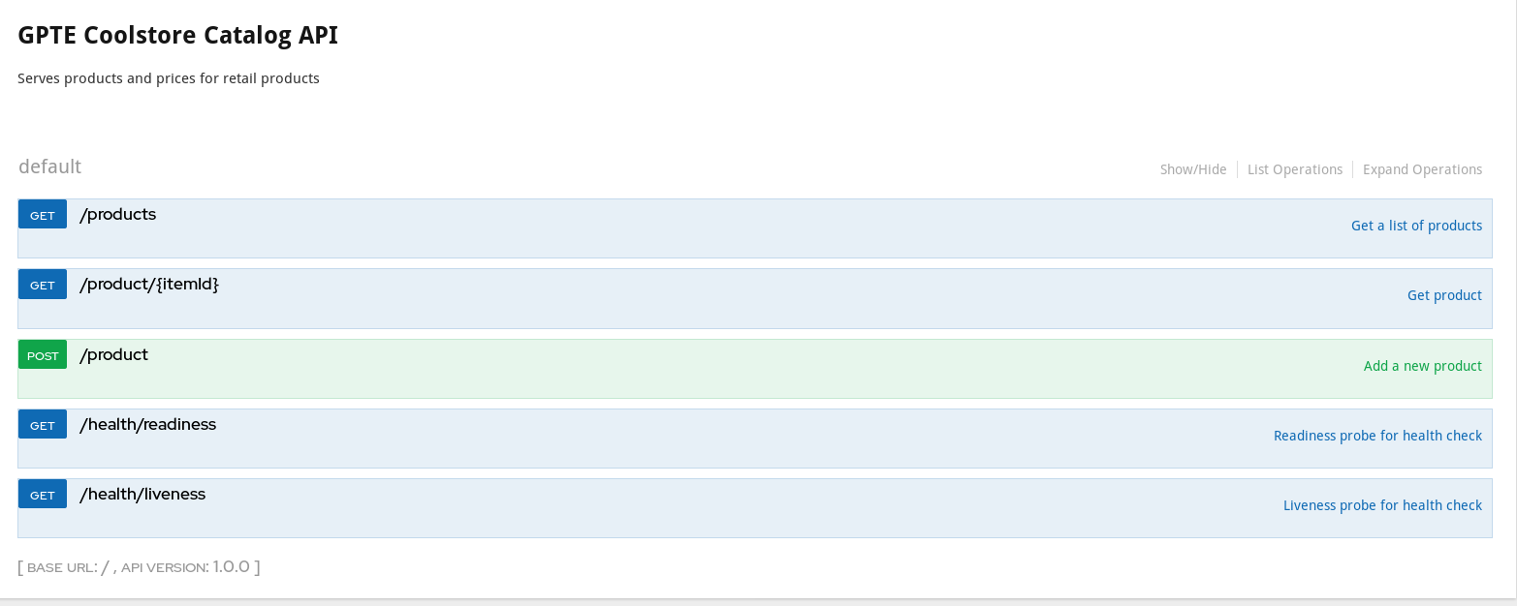
ActiveDocs
Notes:
APIs are the language of digital business. It’s tough to find a company or organization these days that is not exposing APIs to users, customers, clients, and partners as part of their digital transformation. Examples of capabilities required for traditional API programs include:
Scale to large numbers of APIs and request volume
End-to-end security with TLS
Flexible deployment and traffic routing features to support A/B, Blue/Green, Canary deployments
Developer portal to engage and onboard API clients
Client authentication and authorization
Application-level policy control
Analytics
API management is typically used in “north south” architectures where API clients live beyond trust and/or organizational boundaries.
When adopting a next gen application platform for your enterprise, consider what support the platform has for these ‘table stakes’ requirements for an API program.

Slide 63
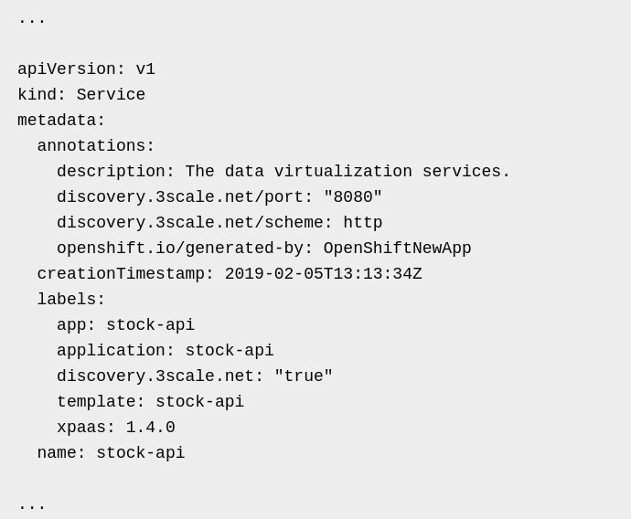
3Scale Service Discovery In-Cluster Services
Notes:
APIs are the language of digital business. It’s tough to find a company or organization these days that is not exposing APIs to users, customers, clients, and partners as part of their digital transformation. Examples of capabilities required for traditional API programs include:
Scale to large numbers of APIs and request volume
End-to-end security with TLS
Flexible deployment and traffic routing features to support A/B, Blue/Green, Canary deployments
Developer portal to engage and onboard API clients
Client authentication and authorization
Application-level policy control
Analytics
API management is typically used in “north south” architectures where API clients live beyond trust and/or organizational boundaries.
When adopting a next gen application platform for your enterprise, consider what support the platform has for these ‘table stakes’ requirements for an API program.

Slide 64
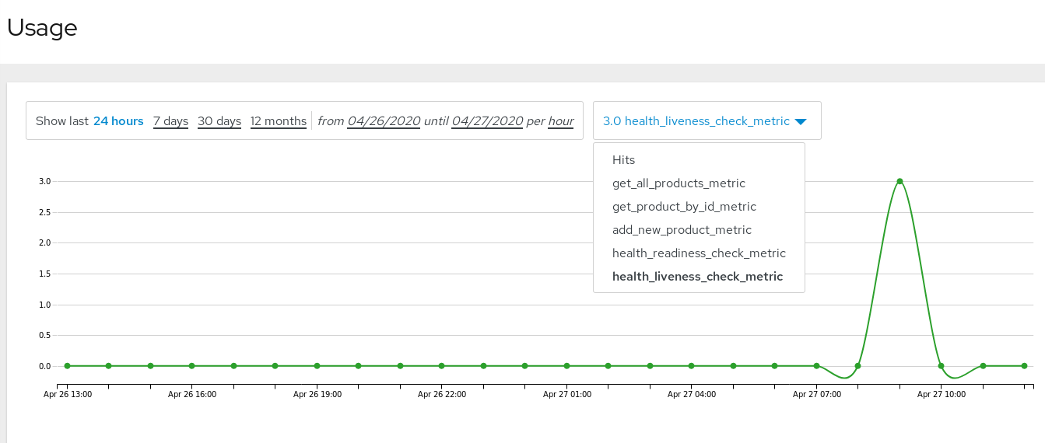
Monitor Usage Per Method
Notes:
APIs are the language of digital business. It’s tough to find a company or organization these days that is not exposing APIs to users, customers, clients, and partners as part of their digital transformation. Examples of capabilities required for traditional API programs include:
Scale to large numbers of APIs and request volume
End-to-end security with TLS
Flexible deployment and traffic routing features to support A/B, Blue/Green, Canary deployments
Developer portal to engage and onboard API clients
Client authentication and authorization
Application-level policy control
Analytics
API management is typically used in “north south” architectures where API clients live beyond trust and/or organizational boundaries.
When adopting a next gen application platform for your enterprise, consider what support the platform has for these ‘table stakes’ requirements for an API program.

Slide 65
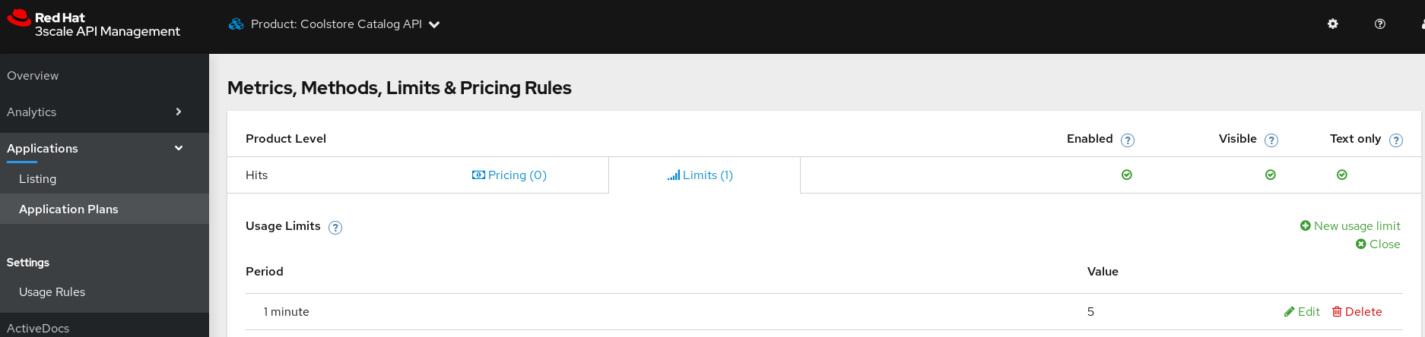
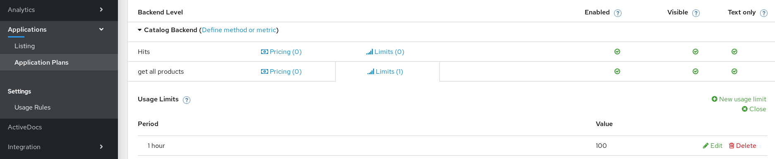
Rate Limit entire API vs. Rate Limit specific method
Notes:
APIs are the language of digital business. It’s tough to find a company or organization these days that is not exposing APIs to users, customers, clients, and partners as part of their digital transformation. Examples of capabilities required for traditional API programs include:
Scale to large numbers of APIs and request volume
End-to-end security with TLS
Flexible deployment and traffic routing features to support A/B, Blue/Green, Canary deployments
Developer portal to engage and onboard API clients
Client authentication and authorization
Application-level policy control
Analytics
API management is typically used in “north south” architectures where API clients live beyond trust and/or organizational boundaries.
When adopting a next gen application platform for your enterprise, consider what support the platform has for these ‘table stakes’ requirements for an API program.

Slide 66
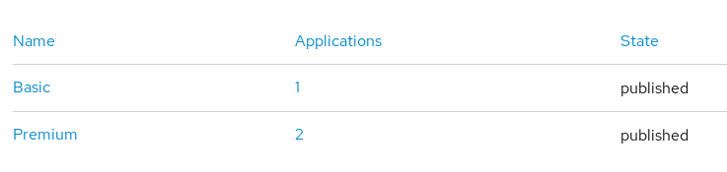
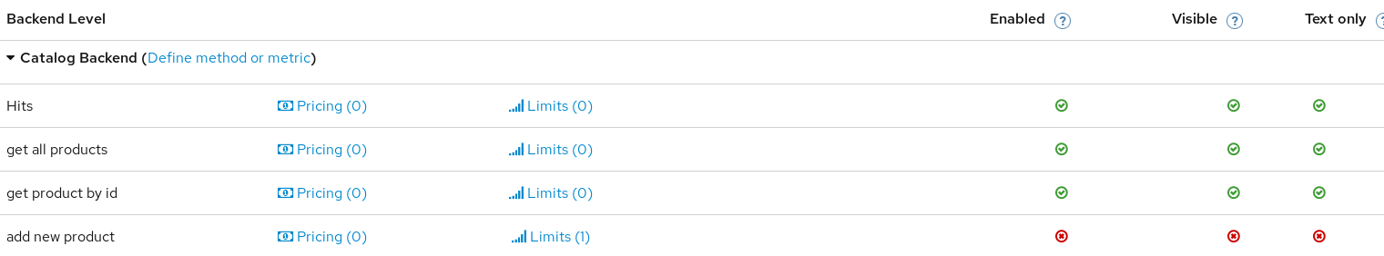
Prevent Access to Specific Method
Notes:
APIs are the language of digital business. It’s tough to find a company or organization these days that is not exposing APIs to users, customers, clients, and partners as part of their digital transformation. Examples of capabilities required for traditional API programs include:
Scale to large numbers of APIs and request volume
End-to-end security with TLS
Flexible deployment and traffic routing features to support A/B, Blue/Green, Canary deployments
Developer portal to engage and onboard API clients
Client authentication and authorization
Application-level policy control
Analytics
API management is typically used in “north south” architectures where API clients live beyond trust and/or organizational boundaries.
When adopting a next gen application platform for your enterprise, consider what support the platform has for these ‘table stakes’ requirements for an API program.

Slide 67
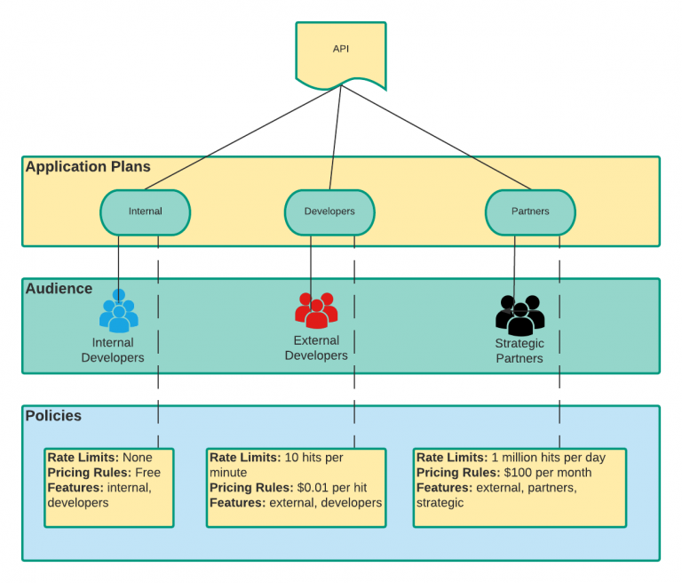
Policy Separation by Group Association
Notes:
APIs are the language of digital business. It’s tough to find a company or organization these days that is not exposing APIs to users, customers, clients, and partners as part of their digital transformation. Examples of capabilities required for traditional API programs include:
Scale to large numbers of APIs and request volume
End-to-end security with TLS
Flexible deployment and traffic routing features to support A/B, Blue/Green, Canary deployments
Developer portal to engage and onboard API clients
Client authentication and authorization
Application-level policy control
Analytics
API management is typically used in “north south” architectures where API clients live beyond trust and/or organizational boundaries.
When adopting a next gen application platform for your enterprise, consider what support the platform has for these ‘table stakes’ requirements for an API program.

Slide 68
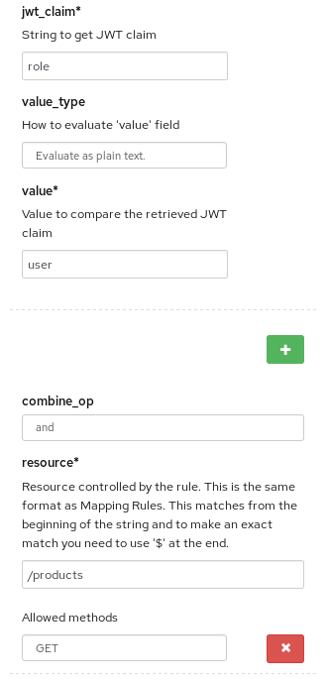
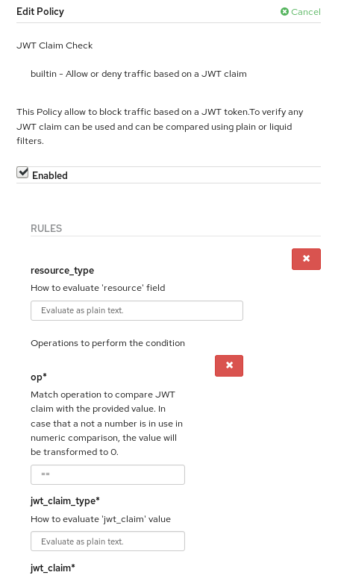
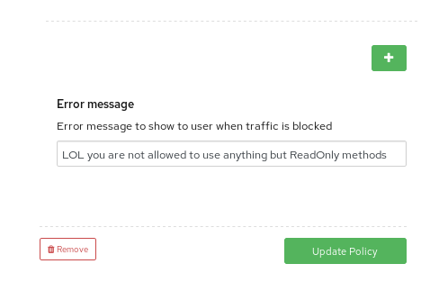
Policies - Examples
JWT fields Validation
Complete Example Reference
Notes:
APIs are the language of digital business. It’s tough to find a company or organization these days that is not exposing APIs to users, customers, clients, and partners as part of their digital transformation. Examples of capabilities required for traditional API programs include:
Scale to large numbers of APIs and request volume
End-to-end security with TLS
Flexible deployment and traffic routing features to support A/B, Blue/Green, Canary deployments
Developer portal to engage and onboard API clients
Client authentication and authorization
Application-level policy control
Analytics
API management is typically used in “north south” architectures where API clients live beyond trust and/or organizational boundaries.
When adopting a next gen application platform for your enterprise, consider what support the platform has for these ‘table stakes’ requirements for an API program.

Slide 69
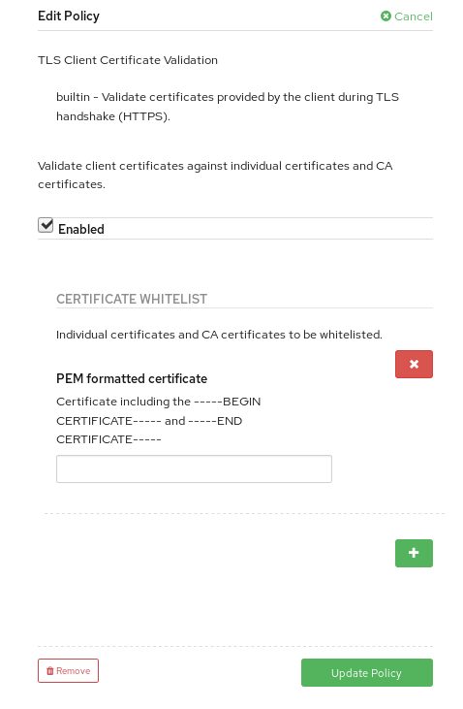
Policies - Examples
TLS Certification Validation
Notes:
APIs are the language of digital business. It’s tough to find a company or organization these days that is not exposing APIs to users, customers, clients, and partners as part of their digital transformation. Examples of capabilities required for traditional API programs include:
Scale to large numbers of APIs and request volume
End-to-end security with TLS
Flexible deployment and traffic routing features to support A/B, Blue/Green, Canary deployments
Developer portal to engage and onboard API clients
Client authentication and authorization
Application-level policy control
Analytics
API management is typically used in “north south” architectures where API clients live beyond trust and/or organizational boundaries.
When adopting a next gen application platform for your enterprise, consider what support the platform has for these ‘table stakes’ requirements for an API program.

Slide 70
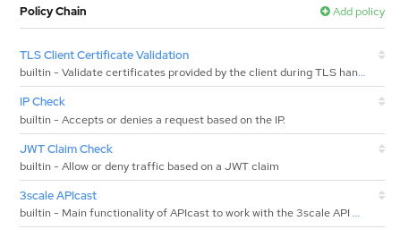
Policies - Examples
Multiple policies & Policy Chain order
Notes:
APIs are the language of digital business. It’s tough to find a company or organization these days that is not exposing APIs to users, customers, clients, and partners as part of their digital transformation. Examples of capabilities required for traditional API programs include:
Scale to large numbers of APIs and request volume
End-to-end security with TLS
Flexible deployment and traffic routing features to support A/B, Blue/Green, Canary deployments
Developer portal to engage and onboard API clients
Client authentication and authorization
Application-level policy control
Analytics
API management is typically used in “north south” architectures where API clients live beyond trust and/or organizational boundaries.
When adopting a next gen application platform for your enterprise, consider what support the platform has for these ‘table stakes’ requirements for an API program.

Slide 71
Do it yourself
Exercise #3
Notes:
APIs are the language of digital business. It’s tough to find a company or organization these days that is not exposing APIs to users, customers, clients, and partners as part of their digital transformation. Examples of capabilities required for traditional API programs include:
Scale to large numbers of APIs and request volume
End-to-end security with TLS
Flexible deployment and traffic routing features to support A/B, Blue/Green, Canary deployments
Developer portal to engage and onboard API clients
Client authentication and authorization
Application-level policy control
Analytics
API management is typically used in “north south” architectures where API clients live beyond trust and/or organizational boundaries.
When adopting a next gen application platform for your enterprise, consider what support the platform has for these ‘table stakes’ requirements for an API program.

Slide 72
Day 2 Deployment Options

Slide 73

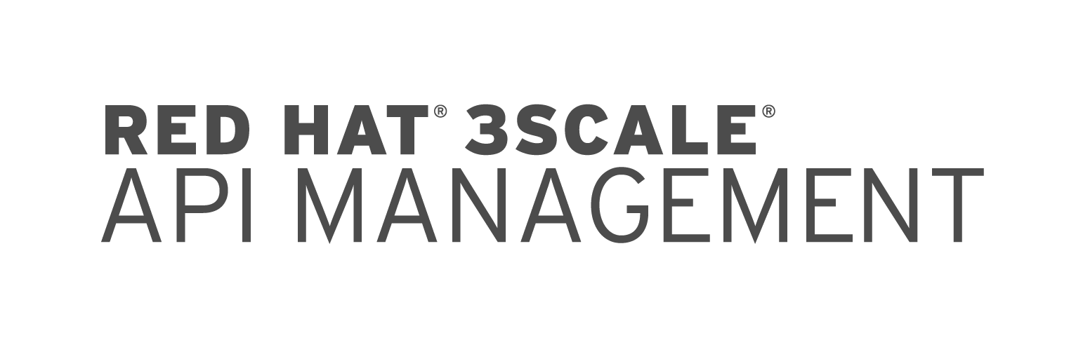
APICast Internal deployment
Internal / Legacy Services
API Backend
API Gateway
Application
API Manager
Notes:
APIs are the language of digital business. It’s tough to find a company or organization these days that is not exposing APIs to users, customers, clients, and partners as part of their digital transformation. Examples of capabilities required for traditional API programs include:
Scale to large numbers of APIs and request volume
End-to-end security with TLS
Flexible deployment and traffic routing features to support A/B, Blue/Green, Canary deployments
Developer portal to engage and onboard API clients
Client authentication and authorization
Application-level policy control
Analytics
API management is typically used in “north south” architectures where API clients live beyond trust and/or organizational boundaries.
When adopting a next gen application platform for your enterprise, consider what support the platform has for these ‘table stakes’ requirements for an API program.

Slide 74
APICast external deployment
Internal Network
AMP - Must Run on OCP
APICast - Can run on every Dockerized environment outside of OCP (Bare Metal / Standard VMs for example)
DMZ
Internal / Legacy Services
API Backend
API Gateway
Application
API Manager
Notes:
APIs are the language of digital business. It’s tough to find a company or organization these days that is not exposing APIs to users, customers, clients, and partners as part of their digital transformation. Examples of capabilities required for traditional API programs include:
Scale to large numbers of APIs and request volume
End-to-end security with TLS
Flexible deployment and traffic routing features to support A/B, Blue/Green, Canary deployments
Developer portal to engage and onboard API clients
Client authentication and authorization
Application-level policy control
Analytics
API management is typically used in “north south” architectures where API clients live beyond trust and/or organizational boundaries.
When adopting a next gen application platform for your enterprise, consider what support the platform has for these ‘table stakes’ requirements for an API program.

Slide 75

APICast External & High Availability
Application
DMZ
LB
API Gateway
API Gateway
Internal Network
API Backend
API Manager
Notes:
APIs are the language of digital business. It’s tough to find a company or organization these days that is not exposing APIs to users, customers, clients, and partners as part of their digital transformation. Examples of capabilities required for traditional API programs include:
Scale to large numbers of APIs and request volume
End-to-end security with TLS
Flexible deployment and traffic routing features to support A/B, Blue/Green, Canary deployments
Developer portal to engage and onboard API clients
Client authentication and authorization
Application-level policy control
Analytics
API management is typically used in “north south” architectures where API clients live beyond trust and/or organizational boundaries.
When adopting a next gen application platform for your enterprise, consider what support the platform has for these ‘table stakes’ requirements for an API program.

Slide 76

Fuse Transformation Layer + 3Scale API Gateway
Relevant Cases
Service is Complex SOAP Endpoint
Non-HTTP protocols: TCP, Messaging
Needs to implement access control and security
Advanced / Content-based Routing
Requires business-based transformations / content handling
Internal Network
DMZ
Internal / Legacy Services
2-layers API Gateway
API Backend
Transformation Layer
API Gateway
Application
API Backend
API Manager
Notes:
APIs are the language of digital business. It’s tough to find a company or organization these days that is not exposing APIs to users, customers, clients, and partners as part of their digital transformation. Examples of capabilities required for traditional API programs include:
Scale to large numbers of APIs and request volume
End-to-end security with TLS
Flexible deployment and traffic routing features to support A/B, Blue/Green, Canary deployments
Developer portal to engage and onboard API clients
Client authentication and authorization
Application-level policy control
Analytics
API management is typically used in “north south” architectures where API clients live beyond trust and/or organizational boundaries.
When adopting a next gen application platform for your enterprise, consider what support the platform has for these ‘table stakes’ requirements for an API program.

Slide 77
APICast Self-Managed APICast Dedicated Per-App, Without risking AMP
App A
App B
Medium Article Guide
NS A
NS B
AMP NS
API Gateway
API Gateway
API Manager
API Backend A
API Backend B
Notes:
APIs are the language of digital business. It’s tough to find a company or organization these days that is not exposing APIs to users, customers, clients, and partners as part of their digital transformation. Examples of capabilities required for traditional API programs include:
Scale to large numbers of APIs and request volume
End-to-end security with TLS
Flexible deployment and traffic routing features to support A/B, Blue/Green, Canary deployments
Developer portal to engage and onboard API clients
Client authentication and authorization
Application-level policy control
Analytics
API management is typically used in “north south” architectures where API clients live beyond trust and/or organizational boundaries.
When adopting a next gen application platform for your enterprise, consider what support the platform has for these ‘table stakes’ requirements for an API program.

Slide 78
Multi-tenant
Master Account
Master Admin
Manage Tenants
Impersonate Tenants
Tenant Admin
Manage tenant admins / users
Access APIs and Admin Portal
Member
Access given services / sections
Installation Guide - My Medium Article
Tenant Account 1
Admin Portal
Developer Portal
Traffic Mgmt / API Gateway
Tenant Account 2
Admin Portal
Developer Portal
Traffic Mgmt / API Gateway
Notes:
APIs are the language of digital business. It’s tough to find a company or organization these days that is not exposing APIs to users, customers, clients, and partners as part of their digital transformation. Examples of capabilities required for traditional API programs include:
Scale to large numbers of APIs and request volume
End-to-end security with TLS
Flexible deployment and traffic routing features to support A/B, Blue/Green, Canary deployments
Developer portal to engage and onboard API clients
Client authentication and authorization
Application-level policy control
Analytics
API management is typically used in “north south” architectures where API clients live beyond trust and/or organizational boundaries.
When adopting a next gen application platform for your enterprise, consider what support the platform has for these ‘table stakes’ requirements for an API program.

Slide 79



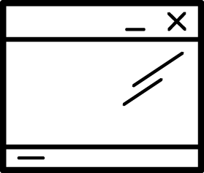


Hybrid Deployment
Public Cloud - Provider A
Hosted / Data Center
API Gateway
API Manager
Mobile Apps
Private Cloud - Provider B
Data Center
API Gateway
API Gateway
Internal Apps
External Apps
Notes:
APIs are the language of digital business. It’s tough to find a company or organization these days that is not exposing APIs to users, customers, clients, and partners as part of their digital transformation. Examples of capabilities required for traditional API programs include:
Scale to large numbers of APIs and request volume
End-to-end security with TLS
Flexible deployment and traffic routing features to support A/B, Blue/Green, Canary deployments
Developer portal to engage and onboard API clients
Client authentication and authorization
Application-level policy control
Analytics
API management is typically used in “north south” architectures where API clients live beyond trust and/or organizational boundaries.
When adopting a next gen application platform for your enterprise, consider what support the platform has for these ‘table stakes’ requirements for an API program.

Slide 80
API SECURITY

Slide 81
Main Security Features
Authentication
OpenID Connect / Basic Auth
Authorization (RBAC)
Application Planes & Access Policies
Method mapping
Built-in & Custom Policies
Drop unwelcome requests by policies rules
Notes:
APIs are the language of digital business. It’s tough to find a company or organization these days that is not exposing APIs to users, customers, clients, and partners as part of their digital transformation. Examples of capabilities required for traditional API programs include:
Scale to large numbers of APIs and request volume
End-to-end security with TLS
Flexible deployment and traffic routing features to support A/B, Blue/Green, Canary deployments
Developer portal to engage and onboard API clients
Client authentication and authorization
Application-level policy control
Analytics
API management is typically used in “north south” architectures where API clients live beyond trust and/or organizational boundaries.
When adopting a next gen application platform for your enterprise, consider what support the platform has for these ‘table stakes’ requirements for an API program.

Slide 82
Main Security Features
Generate Alerts for suspicious traffic
Rate Limiting
Metrics
Advanced Security - Collaboration with other security products
SSO
Service Mesh
K-WAF
Notes:
APIs are the language of digital business. It’s tough to find a company or organization these days that is not exposing APIs to users, customers, clients, and partners as part of their digital transformation. Examples of capabilities required for traditional API programs include:
Scale to large numbers of APIs and request volume
End-to-end security with TLS
Flexible deployment and traffic routing features to support A/B, Blue/Green, Canary deployments
Developer portal to engage and onboard API clients
Client authentication and authorization
Application-level policy control
Analytics
API management is typically used in “north south” architectures where API clients live beyond trust and/or organizational boundaries.
When adopting a next gen application platform for your enterprise, consider what support the platform has for these ‘table stakes’ requirements for an API program.

Slide 83
API SECURITY
Evolution of API Security
Naked API
Simple API Keys (Basic Auth)
Federated Access Control (OIDC)

Slide 84
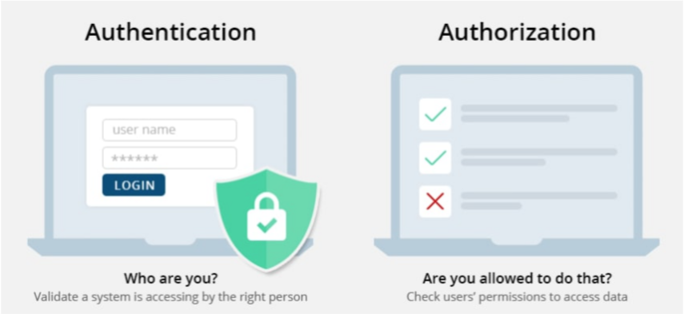
Auth vs. AuthZ
Notes:
APIs are the language of digital business. It’s tough to find a company or organization these days that is not exposing APIs to users, customers, clients, and partners as part of their digital transformation. Examples of capabilities required for traditional API programs include:
Scale to large numbers of APIs and request volume
End-to-end security with TLS
Flexible deployment and traffic routing features to support A/B, Blue/Green, Canary deployments
Developer portal to engage and onboard API clients
Client authentication and authorization
Application-level policy control
Analytics
API management is typically used in “north south” architectures where API clients live beyond trust and/or organizational boundaries.
When adopting a next gen application platform for your enterprise, consider what support the platform has for these ‘table stakes’ requirements for an API program.

Slide 85



AUTHENTICATION
API Key: a shared secret used to authenticate a client application. Cannot easily be renewed.
API Key Pair: an identifier + a shared secret used to authenticate a client application. The identifier remains the same during the whole lifetime of the application, the secret can easily be renewed to ensure higher security.
OpenID Connect: a standard protocol to authenticate the client application and the end-user connected on this application. Currently the highest level of security.
Notes:
APIs are the language of digital business. It’s tough to find a company or organization these days that is not exposing APIs to users, customers, clients, and partners as part of their digital transformation. Examples of capabilities required for traditional API programs include:
Scale to large numbers of APIs and request volume
End-to-end security with TLS
Flexible deployment and traffic routing features to support A/B, Blue/Green, Canary deployments
Developer portal to engage and onboard API clients
Client authentication and authorization
Application-level policy control
Analytics
API management is typically used in “north south” architectures where API clients live beyond trust and/or organizational boundaries.
When adopting a next gen application platform for your enterprise, consider what support the platform has for these ‘table stakes’ requirements for an API program.

Slide 86

OPENID CONNECT - Auth + AuthZ
Built on top of the OAuth 2.0 protocol
Stateless, JWT token
Allows clients to verify the identity of an end user and obtains basic profile information
RESTful HTTP API, using JSON as a data format
My Medium Article - 3Scale & RHSSO (OpenID Connect Implementation)
Notes:
APIs are the language of digital business. It’s tough to find a company or organization these days that is not exposing APIs to users, customers, clients, and partners as part of their digital transformation. Examples of capabilities required for traditional API programs include:
Scale to large numbers of APIs and request volume
End-to-end security with TLS
Flexible deployment and traffic routing features to support A/B, Blue/Green, Canary deployments
Developer portal to engage and onboard API clients
Client authentication and authorization
Application-level policy control
Analytics
API management is typically used in “north south” architectures where API clients live beyond trust and/or organizational boundaries.
When adopting a next gen application platform for your enterprise, consider what support the platform has for these ‘table stakes’ requirements for an API program.

Slide 87

OPENID CONNECT
Provides identity information to the application from the Authority Server
Base64 encoded - easy to work with.
Name: John Doe
Type: Employee
Issued by: Company
Expiration Date: 02-06-2019
Notes:
APIs are the language of digital business. It’s tough to find a company or organization these days that is not exposing APIs to users, customers, clients, and partners as part of their digital transformation. Examples of capabilities required for traditional API programs include:
Scale to large numbers of APIs and request volume
End-to-end security with TLS
Flexible deployment and traffic routing features to support A/B, Blue/Green, Canary deployments
Developer portal to engage and onboard API clients
Client authentication and authorization
Application-level policy control
Analytics
API management is typically used in “north south” architectures where API clients live beyond trust and/or organizational boundaries.
When adopting a next gen application platform for your enterprise, consider what support the platform has for these ‘table stakes’ requirements for an API program.

Slide 88

JWT (“JOT”) to the Rescue
Signed by algo and verified by only correct key
Contains user identity in form of claims (Private, public, reserved)
For OIDC purpose, SSO is widely adopted in consumer/enterprise apps
Eliminates the need to look up against a central access control list
Notes:
APIs are the language of digital business. It’s tough to find a company or organization these days that is not exposing APIs to users, customers, clients, and partners as part of their digital transformation. Examples of capabilities required for traditional API programs include:
Scale to large numbers of APIs and request volume
End-to-end security with TLS
Flexible deployment and traffic routing features to support A/B, Blue/Green, Canary deployments
Developer portal to engage and onboard API clients
Client authentication and authorization
Application-level policy control
Analytics
API management is typically used in “north south” architectures where API clients live beyond trust and/or organizational boundaries.
When adopting a next gen application platform for your enterprise, consider what support the platform has for these ‘table stakes’ requirements for an API program.

Slide 89
3SCALE API GATEWAY POLICIES Modular Policy Architecture Benefits
Descriptive configuration, not code
Add gateway logic with new policies for any phase of the request cycle
Better extensibility
Improved maintainability
Leverage community contributions
OOTB policies configurable from UI
API
Gateway
APIcast Policies
Standard
Applications
Backend
Custom
Community
API
Gateway
Notes:
APIs are the language of digital business. It’s tough to find a company or organization these days that is not exposing APIs to users, customers, clients, and partners as part of their digital transformation. Examples of capabilities required for traditional API programs include:
Scale to large numbers of APIs and request volume
End-to-end security with TLS
Flexible deployment and traffic routing features to support A/B, Blue/Green, Canary deployments
Developer portal to engage and onboard API clients
Client authentication and authorization
Application-level policy control
Analytics
API management is typically used in “north south” architectures where API clients live beyond trust and/or organizational boundaries.
When adopting a next gen application platform for your enterprise, consider what support the platform has for these ‘table stakes’ requirements for an API program.

Slide 90
Built-in Policies
OAuth Token Introspection: Executes OAuth 2.0 token introspection for every API call
Upstream: Allows modify the upstream URL of the request based on its path
Edge Limiting: Algorithm-based rate limiting, allows global and per service caching
Url Rewriting: Allows modification of a path request
SOAP: Adds support for small subset of SOAP
CORS: Enable Cross-Origin Resource Sharing
HTTP Headers: Allows control of HTTP request and response headers
Echo: Prints the request back to the client (status code optional)
Auth Caching: Control 3scale authorization cache
Anonymous Access: Provides default credentials for unauthenticated requests
Logging: Enables / disables access logs per service
Referrer: Sends the contents of the Referer HTTP header to backend so it can be validated
Metrics: Enable backend metrics
Batcher: Caches auth from backend and reports
IP Check: Accepts or denies a request based on the IP
Notes:
APIs are the language of digital business. It’s tough to find a company or organization these days that is not exposing APIs to users, customers, clients, and partners as part of their digital transformation. Examples of capabilities required for traditional API programs include:
Scale to large numbers of APIs and request volume
End-to-end security with TLS
Flexible deployment and traffic routing features to support A/B, Blue/Green, Canary deployments
Developer portal to engage and onboard API clients
Client authentication and authorization
Application-level policy control
Analytics
API management is typically used in “north south” architectures where API clients live beyond trust and/or organizational boundaries.
When adopting a next gen application platform for your enterprise, consider what support the platform has for these ‘table stakes’ requirements for an API program.

Slide 91

Policy Chaining
Notes:
APIs are the language of digital business. It’s tough to find a company or organization these days that is not exposing APIs to users, customers, clients, and partners as part of their digital transformation. Examples of capabilities required for traditional API programs include:
Scale to large numbers of APIs and request volume
End-to-end security with TLS
Flexible deployment and traffic routing features to support A/B, Blue/Green, Canary deployments
Developer portal to engage and onboard API clients
Client authentication and authorization
Application-level policy control
Analytics
API management is typically used in “north south” architectures where API clients live beyond trust and/or organizational boundaries.
When adopting a next gen application platform for your enterprise, consider what support the platform has for these ‘table stakes’ requirements for an API program.

Slide 92
Custom Policies - in depth
Link 1
Notes:
APIs are the language of digital business. It’s tough to find a company or organization these days that is not exposing APIs to users, customers, clients, and partners as part of their digital transformation. Examples of capabilities required for traditional API programs include:
Scale to large numbers of APIs and request volume
End-to-end security with TLS
Flexible deployment and traffic routing features to support A/B, Blue/Green, Canary deployments
Developer portal to engage and onboard API clients
Client authentication and authorization
Application-level policy control
Analytics
API management is typically used in “north south” architectures where API clients live beyond trust and/or organizational boundaries.
When adopting a next gen application platform for your enterprise, consider what support the platform has for these ‘table stakes’ requirements for an API program.

Slide 93
DROP Unwelcome Requests - Examples
Gateway Operations
Checks the timestamp for ‘expired’ token.
Checks the client_id is still valid
Performs a check on the signature of the JWT using RH SSO public key
Notes:
APIs are the language of digital business. It’s tough to find a company or organization these days that is not exposing APIs to users, customers, clients, and partners as part of their digital transformation. Examples of capabilities required for traditional API programs include:
Scale to large numbers of APIs and request volume
End-to-end security with TLS
Flexible deployment and traffic routing features to support A/B, Blue/Green, Canary deployments
Developer portal to engage and onboard API clients
Client authentication and authorization
Application-level policy control
Analytics
API management is typically used in “north south” architectures where API clients live beyond trust and/or organizational boundaries.
When adopting a next gen application platform for your enterprise, consider what support the platform has for these ‘table stakes’ requirements for an API program.

Slide 94


DROP Unwelcome Requests - Examples
TLS Strategies (3Scale 2.7+)
Passthrough
TLS Termination
TLS Forward (Re-Encrypt)
Notes:
APIs are the language of digital business. It’s tough to find a company or organization these days that is not exposing APIs to users, customers, clients, and partners as part of their digital transformation. Examples of capabilities required for traditional API programs include:
Scale to large numbers of APIs and request volume
End-to-end security with TLS
Flexible deployment and traffic routing features to support A/B, Blue/Green, Canary deployments
Developer portal to engage and onboard API clients
Client authentication and authorization
Application-level policy control
Analytics
API management is typically used in “north south” architectures where API clients live beyond trust and/or organizational boundaries.
When adopting a next gen application platform for your enterprise, consider what support the platform has for these ‘table stakes’ requirements for an API program.

Slide 95

ANALYTICS & Alerts Measure the success of your APIs. Take actions based on numbers
Define and present tailored metrics
Drill down up to the API Method level
Implement business metrics
Export data in CSV format
Notes:
APIs are the language of digital business. It’s tough to find a company or organization these days that is not exposing APIs to users, customers, clients, and partners as part of their digital transformation. Examples of capabilities required for traditional API programs include:
Scale to large numbers of APIs and request volume
End-to-end security with TLS
Flexible deployment and traffic routing features to support A/B, Blue/Green, Canary deployments
Developer portal to engage and onboard API clients
Client authentication and authorization
Application-level policy control
Analytics
API management is typically used in “north south” architectures where API clients live beyond trust and/or organizational boundaries.
When adopting a next gen application platform for your enterprise, consider what support the platform has for these ‘table stakes’ requirements for an API program.

Slide 96

ADVANCED SECURITY
A Web Application Firewall can be used to enhance the security of your APIs
API Request
Authorized API Request
Authorized API Request
Developer Apps
Web Application
Firewall
API Gateway
API Backend
Notes:
APIs are the language of digital business. It’s tough to find a company or organization these days that is not exposing APIs to users, customers, clients, and partners as part of their digital transformation. Examples of capabilities required for traditional API programs include:
Scale to large numbers of APIs and request volume
End-to-end security with TLS
Flexible deployment and traffic routing features to support A/B, Blue/Green, Canary deployments
Developer portal to engage and onboard API clients
Client authentication and authorization
Application-level policy control
Analytics
API management is typically used in “north south” architectures where API clients live beyond trust and/or organizational boundaries.
When adopting a next gen application platform for your enterprise, consider what support the platform has for these ‘table stakes’ requirements for an API program.

Slide 97


ADVANCED SECURITY
API Management vs. Service Mesh
Notes:
APIs are the language of digital business. It’s tough to find a company or organization these days that is not exposing APIs to users, customers, clients, and partners as part of their digital transformation. Examples of capabilities required for traditional API programs include:
Scale to large numbers of APIs and request volume
End-to-end security with TLS
Flexible deployment and traffic routing features to support A/B, Blue/Green, Canary deployments
Developer portal to engage and onboard API clients
Client authentication and authorization
Application-level policy control
Analytics
API management is typically used in “north south” architectures where API clients live beyond trust and/or organizational boundaries.
When adopting a next gen application platform for your enterprise, consider what support the platform has for these ‘table stakes’ requirements for an API program.

Slide 98
Automation

Slide 99
Automation Options
Pipelines
3Scale Management API
3Scale Toolbox
Easier to implement
New! YAML-oriented management via 3Scale Operator & GitOps (v2.9-2.10)
3Scale-Operator Github Project & RH 3Scale Official documentation
Github complete example
APIManager CRD Reference
Backend CRD Reference
Product CRD Reference
Tenant CRD Reference
Video Demo
Notes:
APIs are the language of digital business. It’s tough to find a company or organization these days that is not exposing APIs to users, customers, clients, and partners as part of their digital transformation. Examples of capabilities required for traditional API programs include:
Scale to large numbers of APIs and request volume
End-to-end security with TLS
Flexible deployment and traffic routing features to support A/B, Blue/Green, Canary deployments
Developer portal to engage and onboard API clients
Client authentication and authorization
Application-level policy control
Analytics
API management is typically used in “north south” architectures where API clients live beyond trust and/or organizational boundaries.
When adopting a next gen application platform for your enterprise, consider what support the platform has for these ‘table stakes’ requirements for an API program.

Slide 100
External Access to 3Scale (API Calls || Operator)
apiVersion: v1
kind: Secret
metadata:
name: main-three-scale-tenant #admin
type: Opaque
stringData:
adminURL: https://3scale-admin.example.com:443
token: "XXXXXXXXXXXXXXXXXXXXXXXXXXXXXXXXXXXXXXXXXXX"
Medium Article - Example Demo
apiVersion: v1
kind: Secret
metadata:
name: mytenant
type: Opaque
stringData:
adminURL: https://my-3scale-tenant.example.com:443
token: "XXXXXXXXXXXXXXXXXXXXXXXXXXXXXXXXXXXXXXXXXXX"
Notes:
APIs are the language of digital business. It’s tough to find a company or organization these days that is not exposing APIs to users, customers, clients, and partners as part of their digital transformation. Examples of capabilities required for traditional API programs include:
Scale to large numbers of APIs and request volume
End-to-end security with TLS
Flexible deployment and traffic routing features to support A/B, Blue/Green, Canary deployments
Developer portal to engage and onboard API clients
Client authentication and authorization
Application-level policy control
Analytics
API management is typically used in “north south” architectures where API clients live beyond trust and/or organizational boundaries.
When adopting a next gen application platform for your enterprise, consider what support the platform has for these ‘table stakes’ requirements for an API program.

Slide 101
3Scale toolbox
3scale toolbox is a set of tools to help you manage your 3scale product.
Official Project Git Repository
Official Red Hat documentation
Can be installed on laptop or run on podman/docker container
Notes:
APIs are the language of digital business. It’s tough to find a company or organization these days that is not exposing APIs to users, customers, clients, and partners as part of their digital transformation. Examples of capabilities required for traditional API programs include:
Scale to large numbers of APIs and request volume
End-to-end security with TLS
Flexible deployment and traffic routing features to support A/B, Blue/Green, Canary deployments
Developer portal to engage and onboard API clients
Client authentication and authorization
Application-level policy control
Analytics
API management is typically used in “north south” architectures where API clients live beyond trust and/or organizational boundaries.
When adopting a next gen application platform for your enterprise, consider what support the platform has for these ‘table stakes’ requirements for an API program.

Slide 102
3Scale Management API Why work hard when you can automate?
Just do the Exercise - it covers everything
(requires jq)
Notes:
APIs are the language of digital business. It’s tough to find a company or organization these days that is not exposing APIs to users, customers, clients, and partners as part of their digital transformation. Examples of capabilities required for traditional API programs include:
Scale to large numbers of APIs and request volume
End-to-end security with TLS
Flexible deployment and traffic routing features to support A/B, Blue/Green, Canary deployments
Developer portal to engage and onboard API clients
Client authentication and authorization
Application-level policy control
Analytics
API management is typically used in “north south” architectures where API clients live beyond trust and/or organizational boundaries.
When adopting a next gen application platform for your enterprise, consider what support the platform has for these ‘table stakes’ requirements for an API program.

Slide 103
Any Questions?
tamber@redhat.com
https://www.linkedin.com/in/tommeramber/
https://medium.com/@tamber

Slide 104
Thank you
Red Hat is the world’s leading provider of enterprise open source software solutions. Award-winning support, training, and consulting services make Red Hat a trusted adviser to the Fortune 500.

